Slide 1
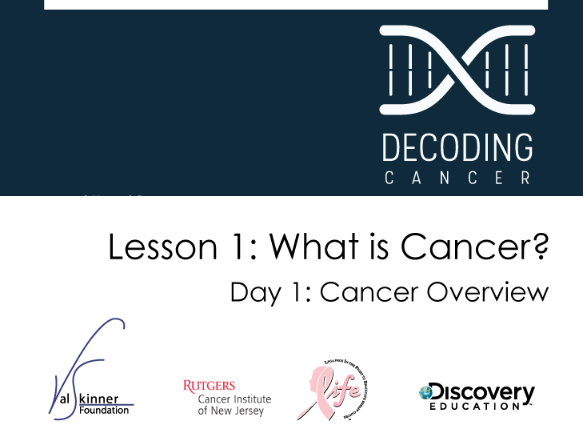
Notes:
Instructor Notes
This lesson focuses on breast cancer. For more detailed information about effective approaches to teaching this course, please review the Educator’s Guide. Information about resources, how to inform parents of the curriculum, and how to expand this lesson for include other forms of cancer are included in that document.

Slide 2

Upon completion of this lesson you will be able to:
Identify common misconceptions about cancer
Create a graphic organizer to represent what you know about cancer
Summarize the characteristics of the cell cycle
and its regulation
Recognize the consequences of uncontrolled cell division
Compare the appearance, structure, function, and replication of healthy cells to those of cancerous cells
Describe how cancer develops
Notes:
Instructor Notes
Lesson Summary: Students meet Steve and Nikki and learn about their mother’s breast cancer. Students identify common misconceptions about cancer and create a graphic organizer to answer the question, “What is cancer?” Students apply their knowledge about cellular structure, function, and growth to understanding the development of cancer at the cellular level. Lesson Duration: Two 45-60 minute class periods

Slide 3

Steve and Nikki are fraternal twins in high school. They recently learned that their
mother has been diagnosed with cancer. They have no idea what this really means for their mom and for them.
Notes:
Instructor Notes
Introduce the class to Steve and Nikki. They are fictional characters who are experiencing their mother’s breast cancer.

Slide 4
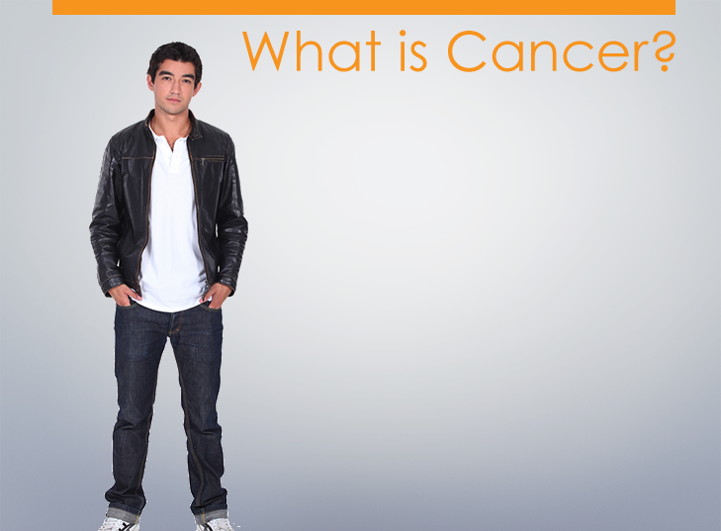
Mom has a doctor’s appointment so she can’t make my game. Dad said he would leave work early to make the game. I’m glad he’s coming but I wish mom could make it and I wonder if we should just stay home.
I still don’t know what cancer really is and Nikki and I don’t want to bug mom and dad. Can someone just tell me what exactly is cancer?
Notes:
Instructor Notes
Tell the class they will develop a response to Steve’s question, “What is Cancer?”
Learning Activity: Small Group Brainstorm
Divide the class into small groups and have students brainstorm what they know about cancer. Use the smart board and write the student responses to this question in the box provided. You can then save the notes the students make to each question by saving by one of the following methods:
-Press Print Screen button on keyboard and past into a word document
-Use the screen capture feature of notebook software that comes with the smart board to add the screen to a set of class notes to be shared with the class later.
-Use PowerPoint’s annotate pen and save the notes to the slide

Slide 5
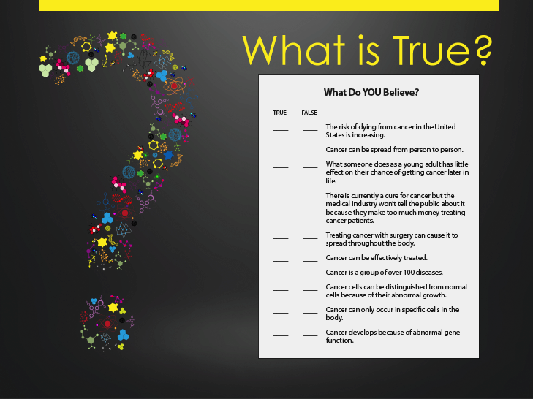
Notes:
Instructor Notes
Hand out worksheet “What Do YOU Believe” and proceed with the learning activity.
Learning Activity: Handout
Ask students to take a few minutes to fill out the handout. Ask them to hold onto them and check their answers as you go through the following slides.

Slide 6

Question 1:
The risk of dying from cancer in the United States is increasing.
FALSE.
The risk of dying from cancer in the United States has decreased from 1975 to 2012.
Notes:
Instructor Notes
Once the “What Do YOU Believe” worksheet has been completed and discussed by the classroom groups, go through the questions in this presentation to learn about the correct answers.

Slide 7

Year of Death | Total | Males | Females
1975 | 17.8 | 0.4 | 31.5
1980 | 18.0 | 0.3 | 31.7
1985 | 18.8 | 0.3 | 33.0
1990 | 18.9 | 0.3 | 33.1
1995 | 17.4 | 0.4 | 30.6
2000 | 15.2 | 0.4 | 26.6
2005 | 13.5 | 0.3 | 24.0
2010 | 12.2 | 0.3 | 21.9
2012 | 11.83 | 0.3 | 21.1
1975-2012 | 16.0 | 0.3 | 28.2
US Mortality Files, National Center for Health Statistics, Centers for Disease Control and Prevention. Rates are per 100,000 and are age-adjusted to the 2000 US Std Population (19 age groups - Census P25-1130). Source: National Cancer Institute. SEER Statistics Review 1975-2006.
Notes:
Instructor Notes
The risk of dying from breast cancer is not increasing in the United States. This graphic shows that in 1980, 31.7 women and 0.3 men per 100,000 people died per year. In 2010, the number of women who died per 100,000 people was 21.9. The total decreased from 18.0 to 12.2.

Slide 8
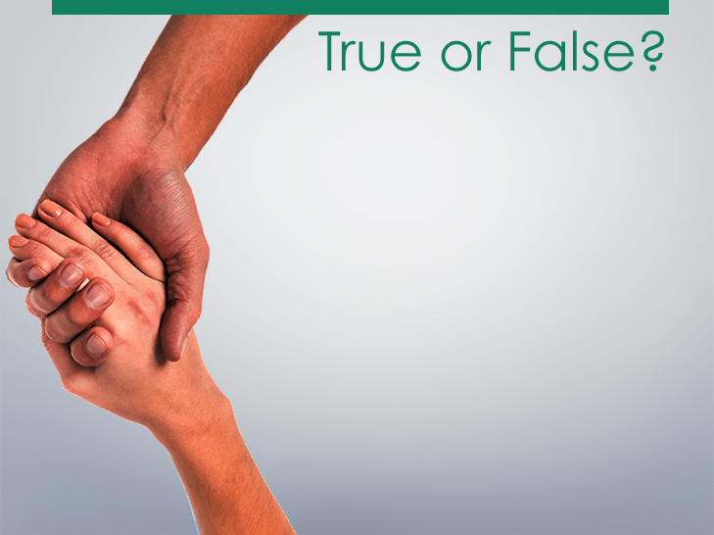
Question 2:
Cancer can be spread from person to person.
FALSE.
Cancer cannot be
passed from one person
to another. Though cancer
itself isn’t contagious, sometimes viruses, which are contagious, can lead to the development of cancer.
Notes:
Instructor Notes
The following is further explanation of viruses that can lead to cancer: Two common cancers caused by viruses are cervical cancer and liver cancer. Human papillomavirus (HPV), a sexually transmitted disease, can cause cervical cancer. And hepatitis C, a virus transmitted through sexual intercourse or use of infected intravenous (IV) needles, can cause liver cancer, though only a small number of those with the virus will develop liver cancer.

Slide 9
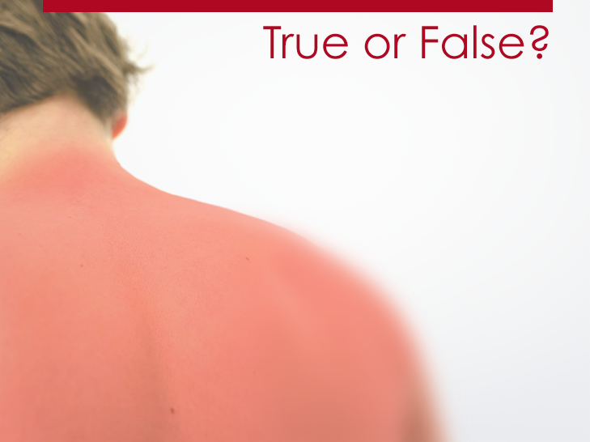
Question 3:
What someone does as a young adult has little effect on their chance of getting cancer later in life.
FALSE.
Most cases of cancer are the consequence of many years of exposure to several risk factors.
Notes:
Instructor Notes
The following is further explanation: What you eat, whether you are physically active, whether you are sunburned, and especially whether you smoke as a young person have a substantial influence on whether you develop cancer later in life.

Slide 10
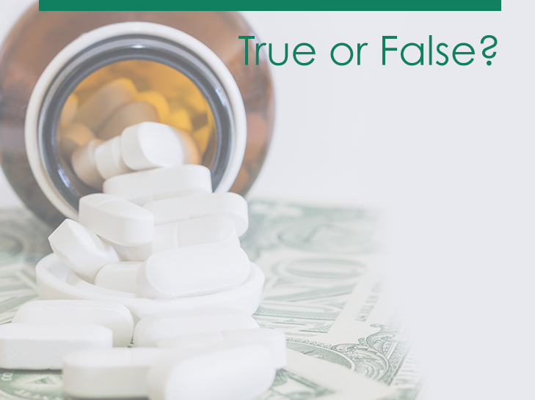
Question 4:
There is currently a cure for cancer but the medical industry won’t tell the public about it because they make too much money treating cancer patients.
FALSE.
Plenty of doctors and their loved
ones die of cancer each year. Why would
anyone hide such an important discovery?
Think about the speed with which other medical breakthroughs in vaccines and antibiotics have been announced and applied.
Notes:
Instructor Notes
The following is further explanation: Remember, cancer is many diseases rather than a single disease, and cures are already available for many forms of cancer. Fewer than half of all people with cancer in the U.S. actually die of the disease.

Slide 11
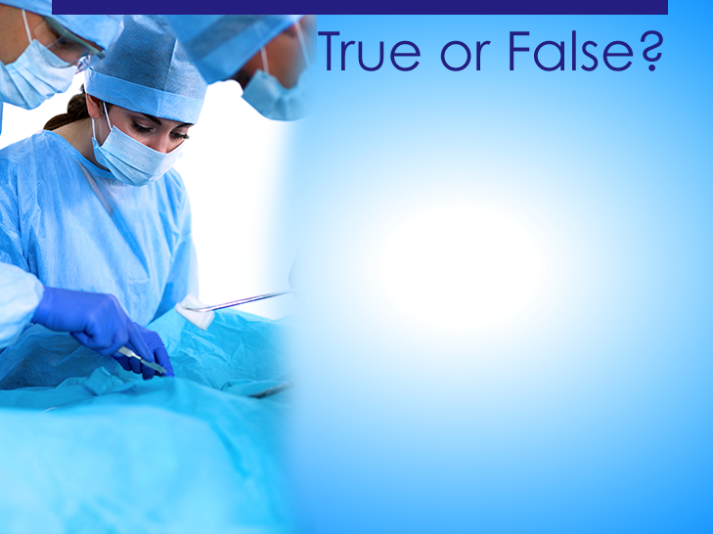
Question 5:
Treating cancer with surgery can cause it to spread throughout the body.
FALSE.
Specialists in cancer surgery know how to safely take biopsy samples and to remove tumors without causing the cancer to spread. In many cases, surgery is an essential part of the cancer treatment plan.

Slide 12

Question 6:
Cancer can be effectively treated.
TRUE.
The five major types of treatment for cancer are surgery, radiation, chemotherapy, biologic therapies, and therapies that boost the patient’s immune system.

Slide 13
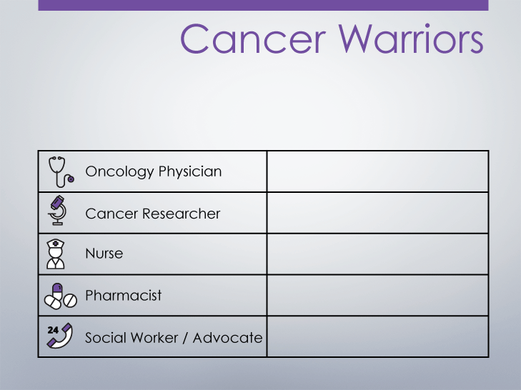
Effective cancer treatments can include several types of Cancer Warriors. What do each of the following professionals do to fight cancer?
Notes:
Instructor Notes
Pause the True/False slides for an activity about the fight on cancer.
Learning Activity: Small Groups
Divide the class into four groups and assign one of the professions listed on the slide to each group. Ask each group to brainstorm ideas of how each role works toward fighting cancer. Ask a member of each group to share what they’ve determined.

Slide 14
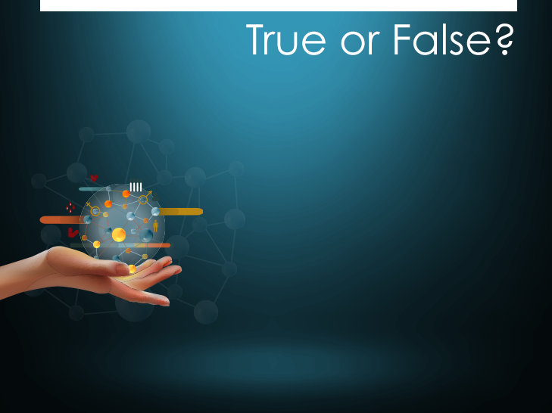
Question 7:
Cancer is a group of over 100 diseases.
TRUE.
The main categories of cancer include:
  Carcinoma
  Sarcoma
  Leukemia
  Lymphoma and myeloma
  Central nervous system cancers
Notes:
Instructor Notes
The following is more explanation of the main categories of cancer:
Carcinoma: cancer that begins in the skin or in tissues that line or cover internal organs
Sarcoma: cancer that begins in bone, cartilage, fat, muscle, blood vessels, or other connective or supportive tissue
Leukemia: cancer that starts in blood-forming tissue, such as the bone marrow, and causes large numbers of abnormal blood cells to be produced and enter the blood
Lymphoma and myeloma: cancers that begin in the cells of the immune system
Central nervous system cancers: cancers that begin in the tissues of the brain and spinal cord

Slide 15
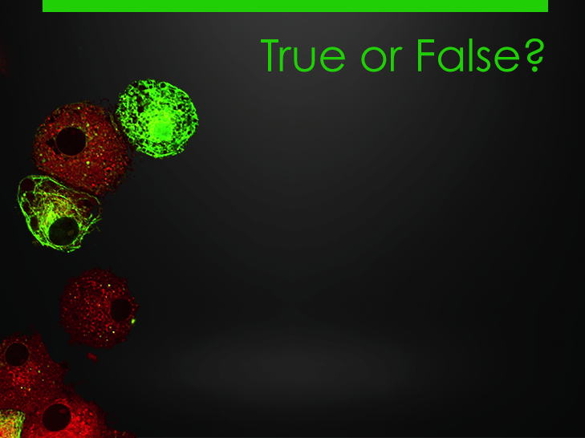
Question 8:
Cancer cells can be distinguished from normal cells because of their abnormal growth.
TRUE.
Normally, cells grow and divide to produce more cells as they are needed to keep the body healthy. Sometimes, this orderly process goes wrong. New cells form when the body does not need them, and old cells do not die when they should.
Notes:
Instructor Notes
This is a photo of cancerous cells.

Slide 16
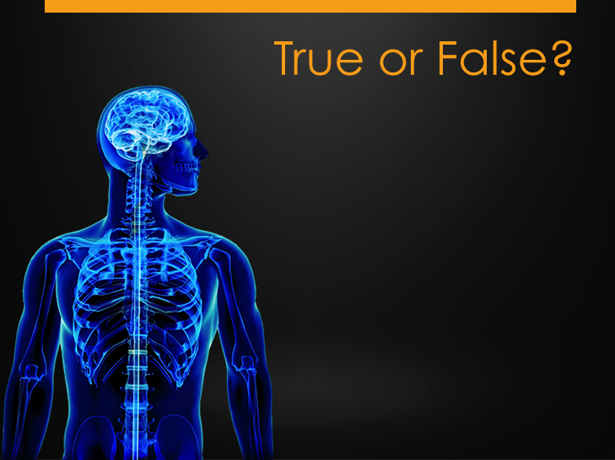
Question 9:
Cancer can only occur in specific cells in the body.
FALSE.
The body is made up of many types of cells, and all cancer begins in cells. Cancer can develop in any cell in the body, which is why there are so many different types.

Slide 17
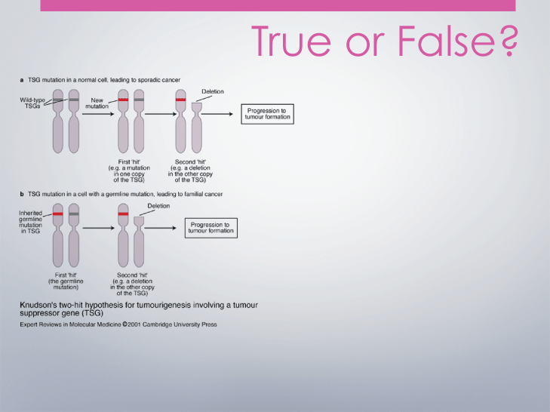
Question 10:
Cancer develops because of abnormal gene function.
TRUE.
Scientists have learned that cancer is caused by changes in genes that normally control the growth and death of cells. Certain lifestyle and environmental factors can change some normal genes into genes that allow the growth of cancer.
Notes:
Instructor Notes
The following is further explanation about abnormal gene function: Many gene changes that lead to cancer are the result of tobacco use, poor diet, exposure to ultraviolet (UV) radiation from the sun, or exposure to carcinogens (cancer-causing substances) in the workplace or in the environment. Some gene alterations are inherited (from one or both parents). However, having an inherited gene alteration does not always mean that the person will develop cancer; it only means that their chance of getting cancer is increased.

Slide 18

Construct a concept map illustrating what you know about cancer. You can use circles, ovals, squares, or other shapes for main concepts or ideas.
Cancer
Notes:
Instructor Notes
Students will work together to create graphic organizers. Hand out the Cancer Concept Map worksheet to begin.
Learning Activity: Think-Pair-Share Graphic Organizer
Ask students to think about what they know about cancer, allowing 1-2 minutes for them to think quietly to themselves. After a few minutes, ask students to pair up with 1 or 2 other students to discuss their thoughts and create a Graphic Organizer or KWL chart. After 4 or 5 minutes, ask each group to share with the rest of the class what they know about cancer. Go around the room asking each group to share what they know about cancer.
Note: A KWL chart is a type of graphic organizer. To make one, have students create the following three columns on a piece of paper: K (what they know about cancer), W (what they want to learn about cancer), and L (what they have learned in the lessons related to cancer). Students should leave room in the L-column for additional information.

Slide 19

Based on what you learned today,
write a response to Steve’s question:
What is cancer?
Notes:
Instructor Notes
Ask students to use their notes, graphic organizers, and everything they learned in class to write a response to Steve’s question, “What is cancer?”

Slide 20
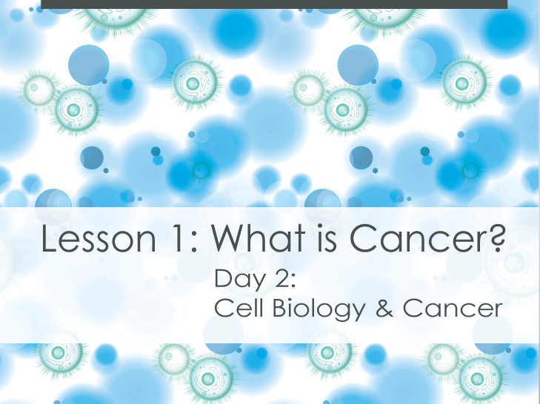
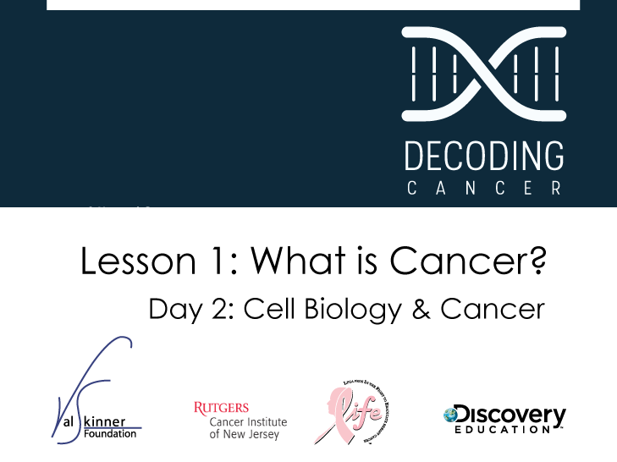

Slide 21
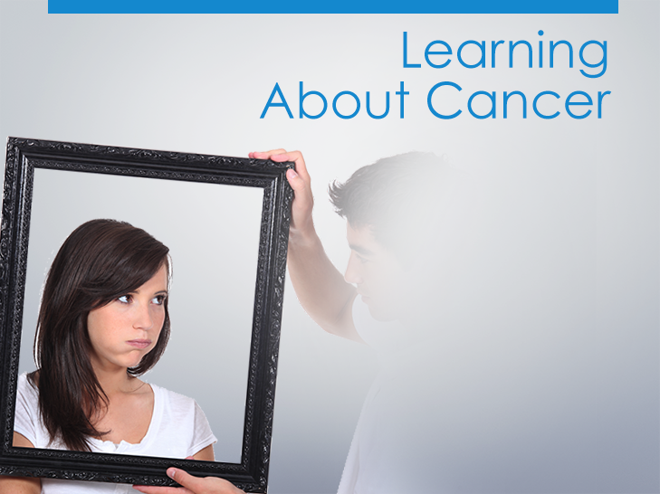
Nikki has a lot of questions and Steve is not sure how to help answer them. What would you want to know if you were in their shoes?
Notes:
Instructor Notes
Remind students about Steve and Nikki, and that they are learning about their mom’s cancer. Ask them to pull out their homework assignment from yesterday.
Learning Activity: Review of homework assignment

Slide 22

I remember learning about the phases of the cell cycle, but don’t understand the deal with cancer. I wonder what mom
went through before now!
I really want to help but I just
keep wondering about what’s
going to happen.
Also, will I get cancer, too?
Notes:
Instructor Notes
Nikki has a lot of questions about cancer. In this next session we’ll discuss cells, cell cycles, and how cancer forms.
Learning Activity: Discussion
Ask students: “What do you believe would be the most useful thing to learn about cancer? What are you most curious about?”

Slide 23
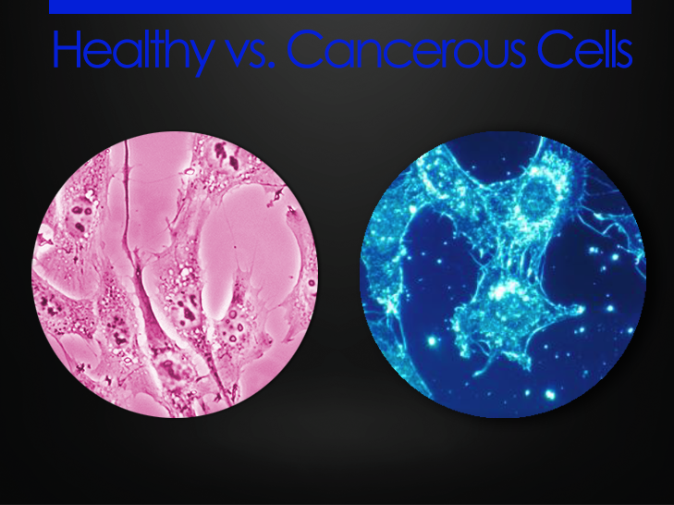
How do healthy and cancerous cells differ?
Healthy
Cancerous
Notes:
Instructor Notes
The following slides will show images of healthy and cancerous cells. Before showing the images, ask the class about differences between healthy and cancerous cells.
Learning Activity: Healthy vs. Cancerous Cells Brainstorm
Ask students to think of how normal and cancerous cells might differ. Write students’ suggestions on the board. Tell students they are next going to compare images of healthy and cancerous cells, then divide the class into small groups of four to six students.

Slide 24
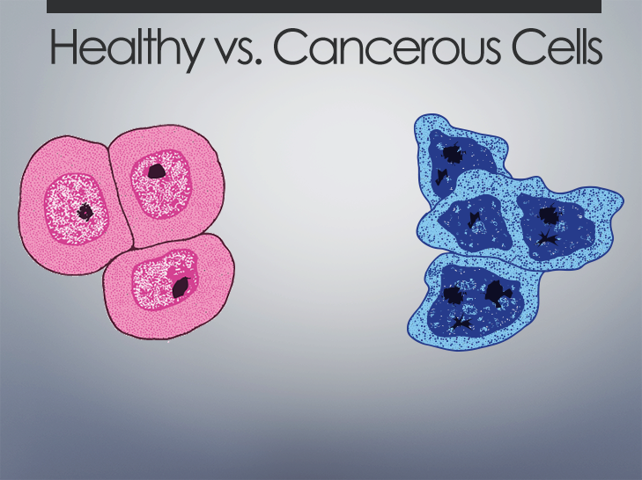
Healthy
Cancerous
Cytoplasm
Nucleus
Chromatin
Nucleolus
Notes:
Instructor Notes
Learning Activity: Small Groups
Show this slide of Normal and Cancer Cells-Structure. Allow groups enough time to study the images and list any differences they observe. Tell the class you will be returning to these images at the end of the lesson to discuss their answers.

Slide 25
Healthy
Cancerous
Cytoplasm
Nucleus
Chromatin
Nucleolus
Large Cytoplasm
Single Nucleus
Single Nucleolus
Fine Chromatin
Small Cytoplasm
Multiple Nuclei
Multiple & Large Nucleoli
Coarse Chromatin
Notes:
Instructor Notes
Discuss differences between normal and cancerous cells, including:
Normal cells have a large cytoplasm; cancerous cells have a small cytoplasm
Normal cells have a single nucleus; cancerous cells have multiple nuclei
Normal cells have a nucleolus; cancerous cells have multiple and large nucleoli
Normal cells have fine chromatin; cancerous cells have coarse chromatin

Slide 26

Less
Characteristics of Normal & Cancerous Cells
 | Normal | Cancerous
Number of Cells
Shape of Cells
Number of Nuclei
Amount of Cytoplasm
Less
Less
Less
Even
More
More
More
Irregular

Slide 27
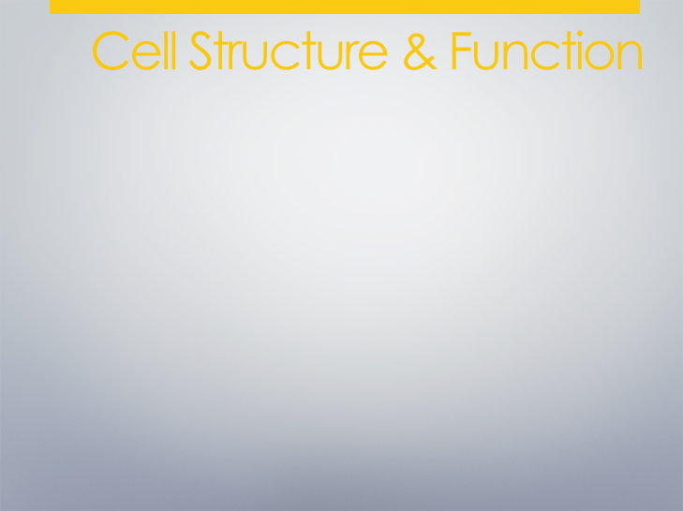
Structure Function
Nucleus _________________________________________
Mitochondria _________________________________________
Ribosomes _________________________________________
Golgi Apparatus _________________________________________
Centrioles _________________________________________
Chromosomes _________________________________________
Endoplasmic Reticulum _________________________________________
Notes:
Instructor Notes
Hand out the Cell Structure and Function Worksheet to the class and give them a few minutes to fill it out. Next, discuss the answers as a class before moving onto the next slide.
NOTE: This is an optional slide for review. Use or delete this slide depending on the needs of the students.

Slide 28
Nucleus
Control center of the cell. Contains all genetic information.
Mitochondria
Powerhouse of the cell.
Converts sugar to usable energy by cellular respiration.
Ribosomes
Site of protein synthesis.
Golgi Apparatus
Packaging center of the cell. Packages and secretes proteins.
Centrioles
Organizes microtubules (spindle fibers) for mitosis.
Chromosomes
Made of condensed DNA and proteins. Codes for genetic traits.
Endoplasmic Reticulum
Transports intracellular materials.
Notes:
Instructor Notes
Review answers to Cell Structure and Function Worksheet.
NOTE: This is an optional slide for review. Use or delete this slide depending on the needs of the students.

Slide 29
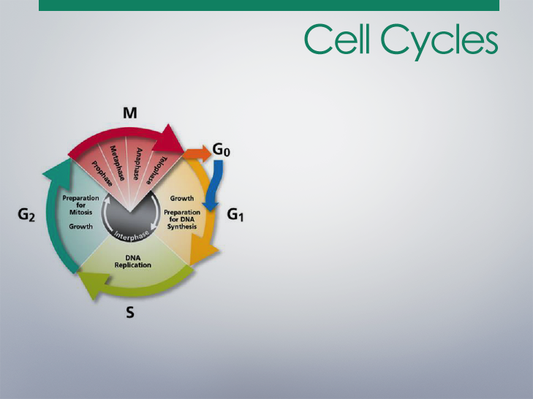
Phases of Cell Cycle
Gap 0 (G0): Resting Stage
Gap 1 (G1): Growth
Synthesis (S): DNA Replication
Gap 2 (G2): Growth
Mitosis (M): Nuclear Division and Cytokinesis
Notes:
Instructor Notes
Review cell cycle and regulation.
Gap 0 (G0) Phase is the resting stage, when a cell leaves the cell cycle, either temporarily or permanently. Often they will never reenter the cell but instead will carry out their function in the organism until they die.
GAP 1 (G2) Phase includes growth and prep of chromosomes for replication.
Synthesis (S) Phase is where DNA replication occurs.
GAP 2 (G2) Phase includes preparation for mitosis.
Mitosis (M) Phase is where nuclear and cytoplasmic division occur. Mitosis is further divided into 4 phases (prophase, metaphase, anaphase, telophase).

Slide 30
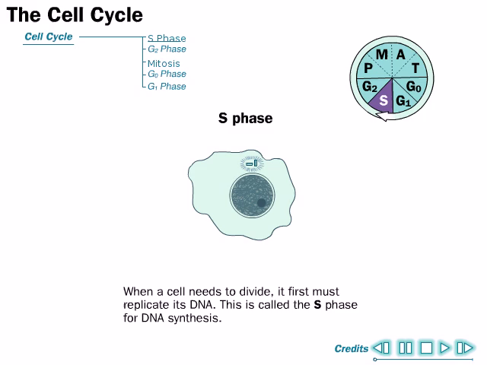
Source: The presidents and Fellows of Harvard College., 2013
Notes:
Instructor Notes
This animation is also helpful: http://www.cellsalive.com/cell_cycle_js.htm

Slide 31
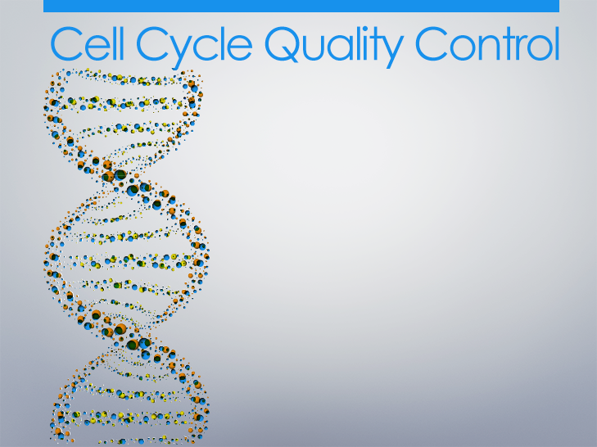
The cell has several systems for interrupting the cell cycle if something goes wrong.
Checkpoints in G1 and G2 look for DNA damage and try to repair it.
Damage that is so severe that it cannot be repaired will lead a cell to self-destruct by apoptosis.
Mitosis checkpoint detects failure of spindle fibers to attach to kinetochores and will arrest cell in metaphase until corrected.
Notes:
Instructor Notes
Review of quality control of the cell cycle.

Slide 32
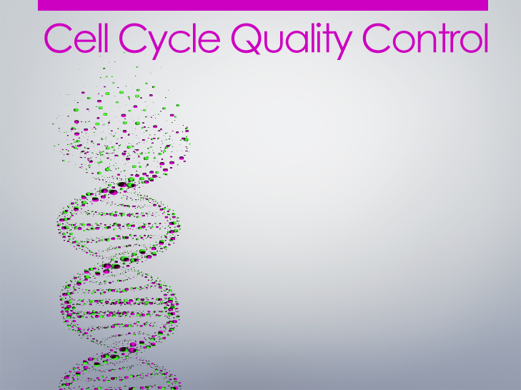
All checkpoints require the function of a complex of proteins. Mutations in the genes encoding some of these proteins have been associated with cancer.
Checkpoint failures due to gene mutations allow the cell to continue dividing despite damage to its integrity.
Notes:
Instructor Notes
Review of quality control of the cell cycle.

Slide 33
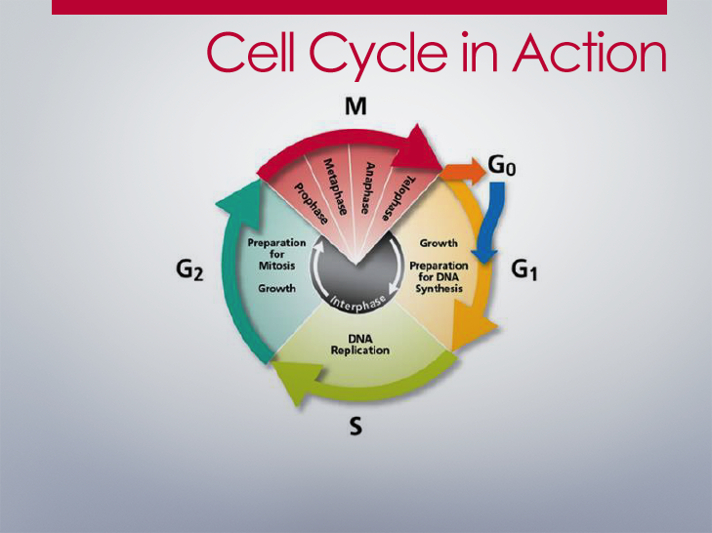
Notes:
Instructor Notes
This exercise will help students demonstrate their knowledge of the cell cycle.
Learning Activity: Jigsaw Cell Cycle Activity
Divide the class into 5 groups, and arrange the groups into a circle. Assign each group to be one of the following:
Gap 0 (G0) Phase
GAP 1 (G2) Phase
Synthesis (S) Phase
GAP 2 (G2) Phase
Mitosis (M) Phase
Walk from phase to phase and ask each group to explain what their function is. Ask individual students to provide detailed information about their role. Assign specific roles (prophase, metaphase, anaphase, telophase) within Mitosis Phase and other areas where it makes sense. Switch members of groups around and repeat the activity.

Slide 34
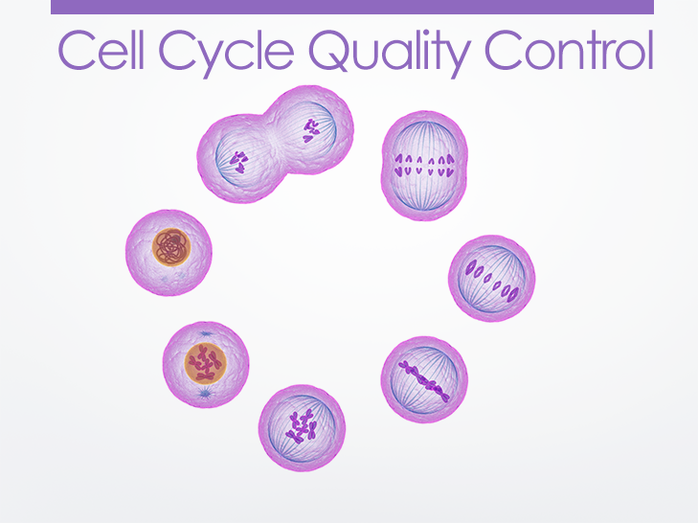
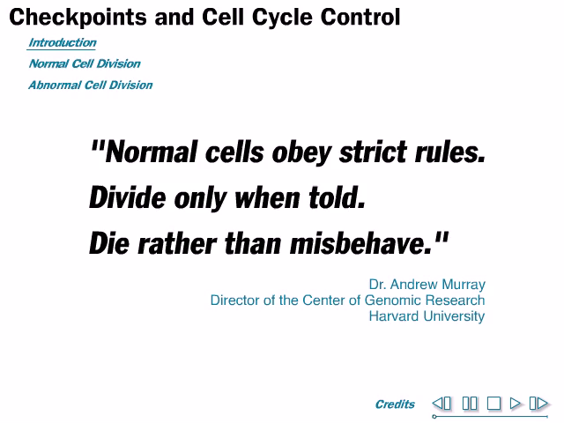
Source: The presidents and Fellows of Harvard College., 2013
Notes:
Instructor Notes
Link to the following video: http://outreach.mcb.harvard.edu/animations/checkpoints.swf

Slide 35
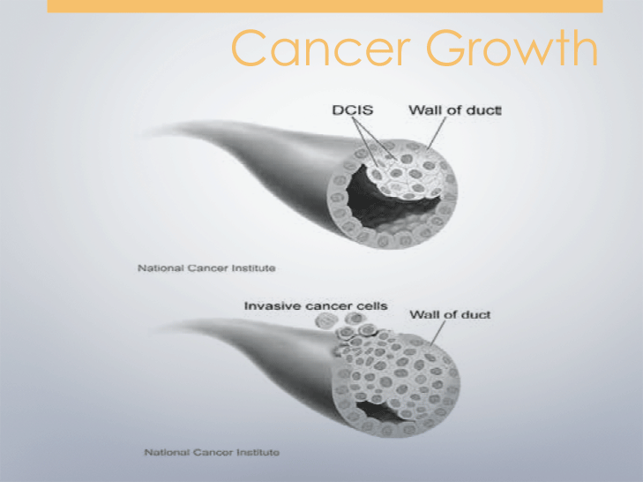
Cell Cycle Quality Control
Source- Don Bliss for the National Cancer Institute
Notes:
Instructor Notes
Explain to students that there are two types of mutation that can lead to uncontrolled cell division and cancer: Tumor Suppressor Gene Mutations and Proto-oncogene Mutations.

Slide 36
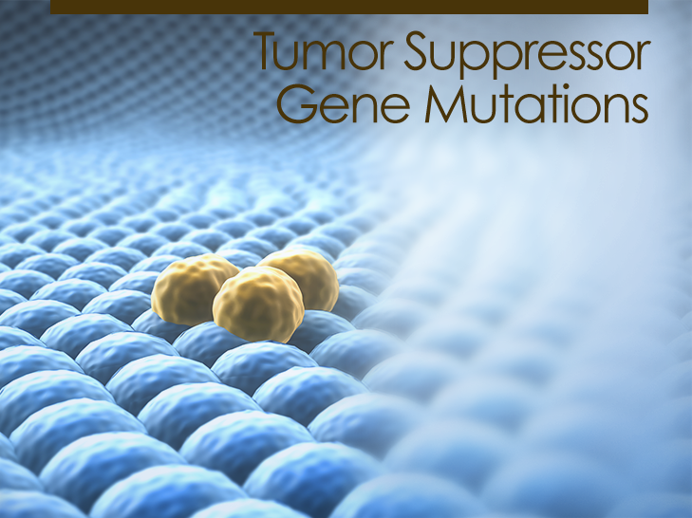
When a tumor suppressor gene is mutated, there is loss of function resulting in cell cycle checkpoint failure and uncontrolled division of abnormal cells.
Notes:
Instructor Notes
Remind students that everyone has tumor suppressor genes and proto-oncogenes. Normally, both work fine and cells do not grow out of control. However, mutations in either or both of these types of genes change their function, which may lead to cancer. Explain that usually the cells in Tumor Suppressor Gene Mutation and Proto-Oncogene Mutation would go through apoptosis; however, cancer cells avoid apoptosis and keep growing and dividing, resulting in a tumor. This is a recessive mutation so both alleles in the gene need to be mutated to cause the cancer.
Animation of Tumor
Suppressor Gene Mutation example: Retinoblastoma https://www.youtube.com/watch?v=0GlOb76xPW4

Slide 37

Tumor suppressor genes are like the brakes of a car.
When the brakes lose function, the car moves out of control.
Similarly, when tumor suppressor genes lose function, the cells grow out of control.
Notes:
Instructor Notes
Use this real-world comparison to further explain Tumor Suppressor Gene Mutation.

Slide 38
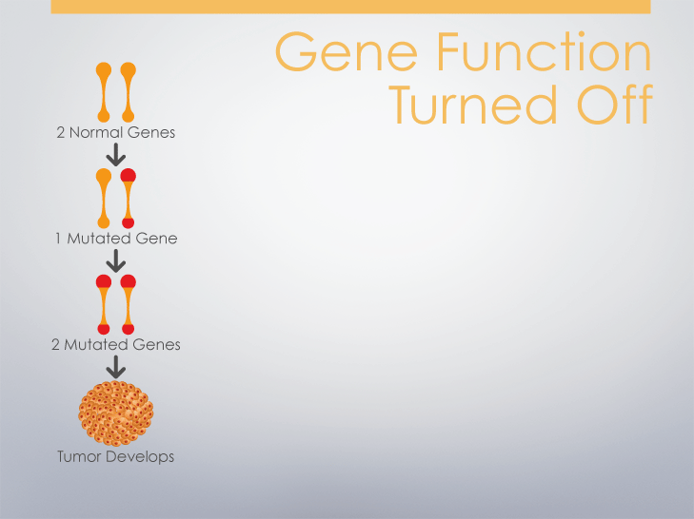
Tumor suppressor genes are like the brakes of a car.
When the brakes lose function, the car moves out of control.
Similarly, when tumor suppressor genes lose function, the cells grow out of control.
Notes:
Instructor Notes
Discuss the concept of losing both copies of the gene, and how it is linked to the tumor suppressor function. Note that this is the same graphic students saw on Slide 17 – the repetition of this graphic is meant for reinforcement of the concept.

Slide 39
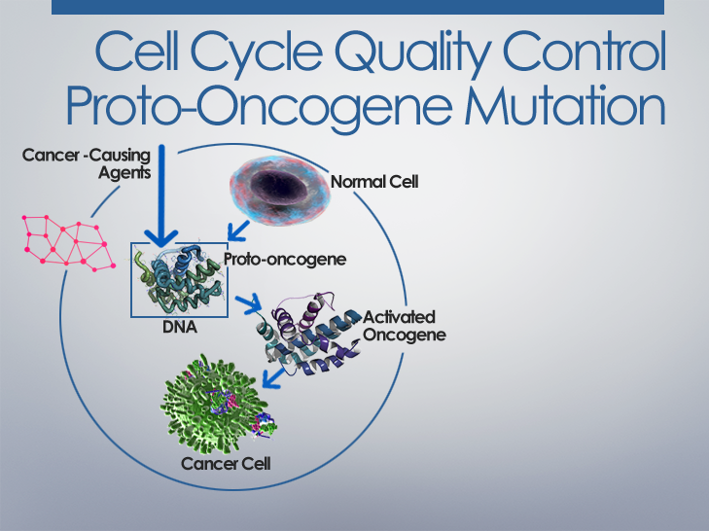
When a proto-oncogene is mutated (now called oncogene), there is gain of function resulting in a cell cycle checkpoint failure and uncontrolled division of abnormal cells.
Notes:
Instructor Notes
Remind students that everyone has tumor suppressor genes and proto-oncogenes. Normally, both work fine and cells do not grow out of control. However, mutations in either or both of these types of genes change their function, which may lead to cancer. Explain that usually the cells in Tumor Suppressor Gene Mutation and Proto-Oncogene Mutation would go through apoptosis; however, cancer cells avoid apoptosis and keep growing and dividing, resulting in a tumor.
Proto-oncogenes are a dominant gene mutation so only one allele needs to be mutated to cause cancer.

Slide 40
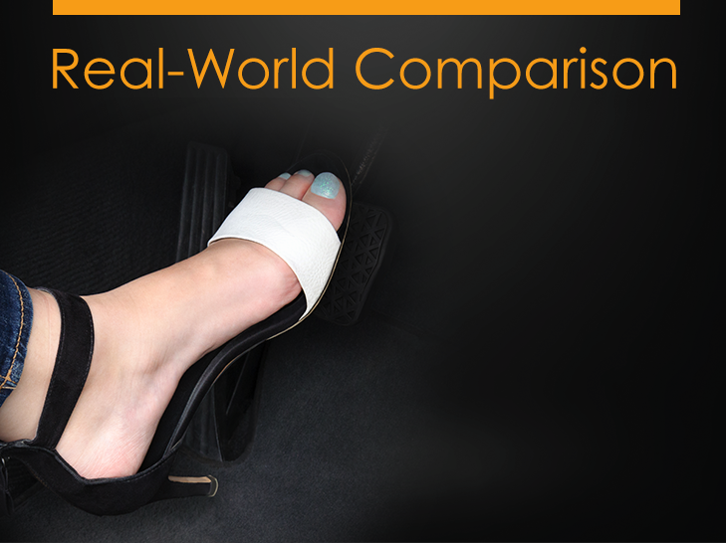
Proto-oncogenes are like the gas pedal of a car.
If the gas pedal gets stuck in the “on” position, a car keeps moving whether the pedal is pushed or not.
Similarly, when a proto-oncogene mutates into an oncogene, a cell will keep dividing even when there are no messages to divide
Notes:
Instructor Notes
Use this real-world comparison to further explain Proto-Oncogene mutation.

Slide 41
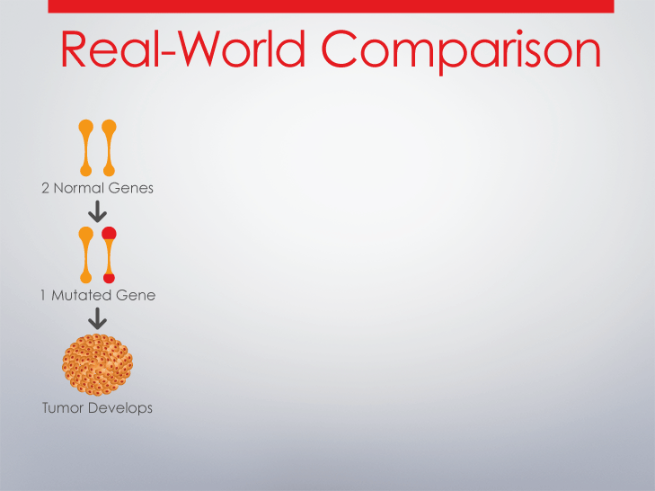
Gene function is activated
Proto-oncogenes are like the gas pedal of a car.
If the gas pedal gets stuck in the “on” position, a car keeps moving whether the pedal is pushed or not.
Similarly, when a proto-oncogene mutates into an oncogene, a cell will keep dividing even when there are no messages to divide.
Notes:
Instructor Notes
Explain to students that most cancers have both loss of brakes and the gas pedal on. Note that this is the same graphic students saw on Slide 17 – the repetition of this graphic is meant for reinforcement of the concept.

Slide 42
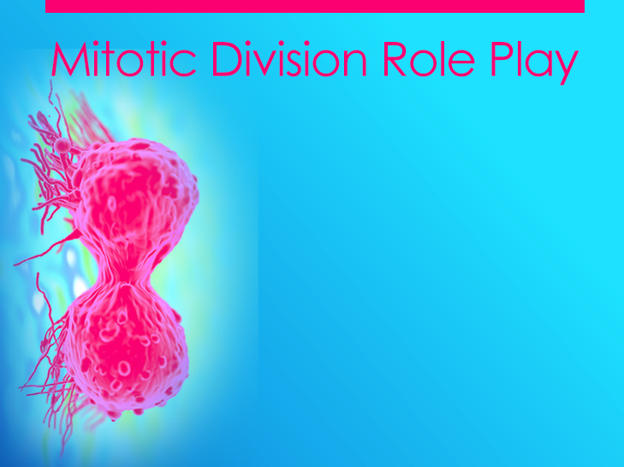
Normal Cell Division
The cell proceeds with normal cell division. At least one error is detected at one or more cell cycle checkpoints. Once the errors are repaired and checkpoints are cleared, the cell divides normally.
Tumor Suppressor Gene Mutation
Tumor suppressor gene loses function.
cells will continue to divide.
Proto-oncogene Mutation
Proto-oncogene mutates into an oncogene. The cells will continue to divide.
Notes:
Instructor Notes
Tell students they are going to demonstrate their understanding of the relationship between the cell cycle and the development of cancer by acting out the cell cycles of healthy and cancerous cells. Remind students that everyone has tumor suppressor genes and proto-oncogenes. Normally, both genes work fine and cells do not grow out of control. However, mutations in either or both of these types of genes change their function, which may lead to cancer. There are three different scenarios: Normal Cell Division, Tumor Suppressor Gene Mutation, and Proto-Oncogene Mutation.
NOTE: This is an optional activity. Use or delete this slide and the following slide depending on whether you’d like to use it.

Slide 43
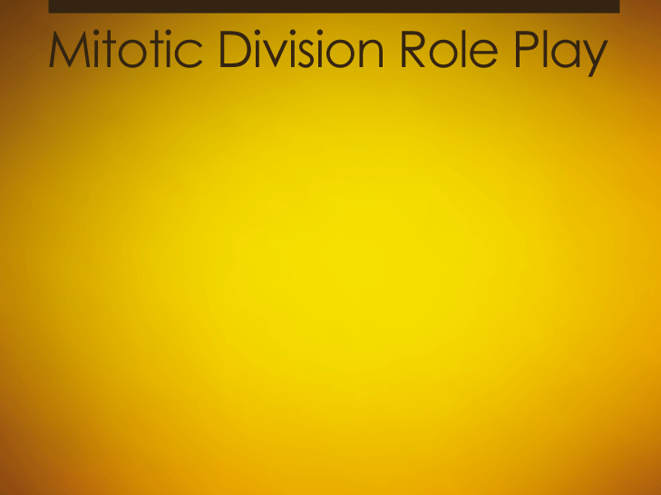
What is the difference between the three cell division scenario? Let’s find out.
Divide into three groups and assign parts for a role play.
1
2
3
Notes:
Instructor Notes
Divide the class into three groups and pass out one of each of the following scripts to the students in each group: Normal Cell Division Script, Tumor Suppressor Gene Mutation Script, and Proto-oncogene Mutation Script. Go through the Learning Activity below.
Learning Activity: Assign each group a scenario to review. Assign or have students select a role. Students can prepare for their role in several ways. Students can review the scenario script. More advanced students can write their own scripts. Give each group nametags and ask them to write their role on their name tag. The following players are needed for each scenario:
Voiceover/Teacher (1)
Narrator (1)
Enzyme 1 (1)
Enzyme 2 (1)
Cell Membrane (2)
Centrioles (2)
DNA/Chromatids (6) (Have students write DNA on one side of their nametag and Chromatid on the other side.)
Mutated Chromatids/Mutated DNA 1 molecules (6)
Nuclear Membrane/Envelope (2)
Take the class to a large space, such as an all-purpose room or gym. Provide students with the appropriate prop or sign for their role. Place two large pieces of yarn in a circle to represent the Cell Membrane. A smaller circle of yarn in the center of the Cell represents the Nuclear Envelope. Two students will be responsible for moving the yarn during the role-play.
Allow students time to practice and then present their Cell Cycle skit to the rest of the class. Students presenting Normal Cell Division go first, followed by the groups presenting Tumor Suppressor Gene Mutation and Proto-oncogene Mutation. While each group presents their skit, the teacher can show cell cycle images or run the animations. As a class, discuss each skit after it has been performed. Discuss what happened and compare it with the other skits.
Tell students that usually the cells in Tumor Suppressor Gene Mutation and Proto-oncogene Mutation would go through apoptosis. However, cancer cells avoid apoptosis and keep growing and dividing, resulting in a tumor.

Slide 44
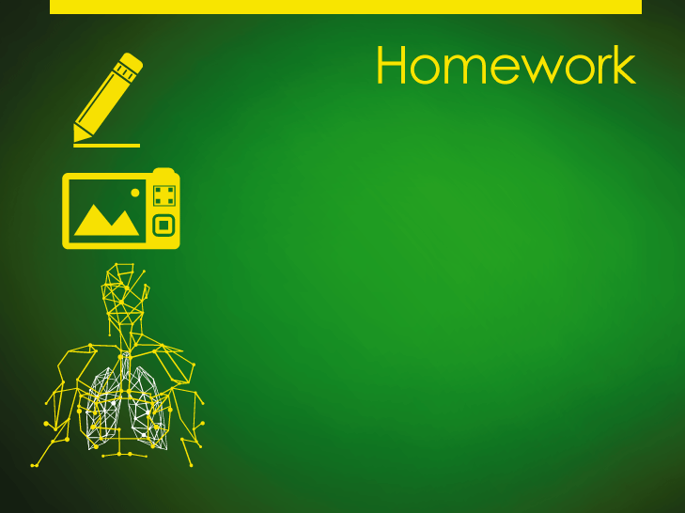
Create a model that explains the relationship between the cell cycle and the development of cancer. Your model can be an illustration, a description, a video explanation, or a physical representation.
Notes:
Instructor Notes
Ask students to demonstrate their understanding of the relationship between the cell cycle and cancer by creating a model.
Alternative Homework Assignments:
Option 1: Have students write an imaginary conversation between the cell, proto-oncogene, and tumor-suppressor gene.
Option 2: Ask students to describe how the role-play could be used to demonstrate meiosis.

Slide 45

I remember learning about the
phases of the cell cycle, but don’t understand the deal with cancer.
I wonder what mom went through before now! I really want to help but I just keep wondering about what’s going to happen. Also, will I get cancer, too?
Notes:
Instructor Notes
Ask the class to write a response to Nikki’s questions about how the cell cycle relates to cancer.
Use the smart board and write the student responses to this question in the box provided. You can then save the notes the students make to each question by saving by one of the following methods:
-Press Print Screen button on keyboard and paste into a word document
-Use the screen capture feature of notebook software that comes with the smart board to add the screen to a set of class notes to be shared with the class later.
-Use PowerPoint’s annotate pen and save the notes to the slide

Slide 46
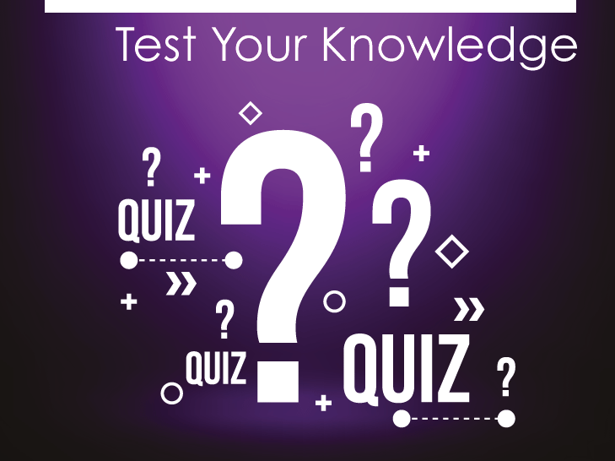
Notes:
Instructor Notes
Pass out the Lesson 1 Quiz to assess students’ understanding of Lesson 1 objectives.

