Slide 1
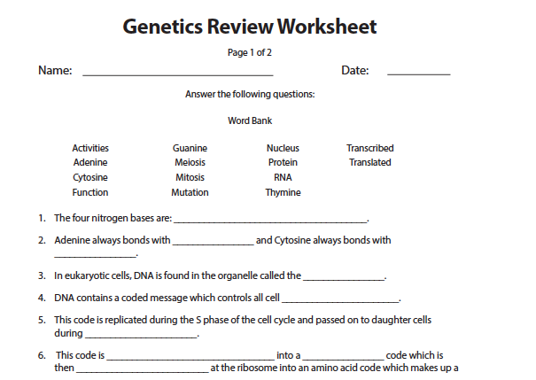
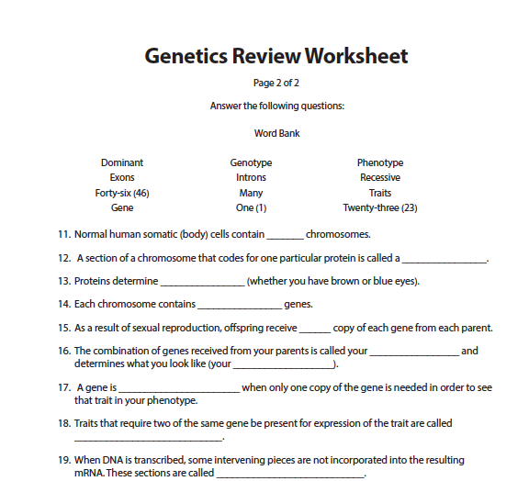
Pre-Lesson Prep Assignment
Notes:
Instructor Notes
Optional pre-lesson prep assignment: One class session before beginning this lesson on Cancer Genetics, distribute the Genetics Review Worksheet for students to complete for homework. Review areas of concern or confusion with the class. Ask students to use their textbooks or search the web to help them with the homework if they need help.

Slide 2
Pre-Lesson Prep Review
Notes:
Instructor Notes
Optional pre-lesson prep assignment: At the beginning of Day 1 of the Cancer Genetics lesson, discuss the Genetics Review Worksheet students completed for homework. Review areas of concern or confusion with the class. Answers to the review sheet are below.
1. The four nitrogen bases are: Adenine, Thymine, Guanine and Cytosine.
2. Adenine always bonds with thymine and Cytosine always bonds with guanine.
3. In eukaryotic cells, DNA is found in the organelle called the nucleus.
4. DNA contains a coded message which controls all cell activities.
5. This code is replicated during the S phase of the cell cycle and passed on to daughter cells
during mitosis.
6. This code is transcribed into a RNA code which is then translated at the ribosome into an amino
acid code which makes up a protein.
7. Any change to the DNA code is called a mutation and may affect the amino acid sequence in the
coded protein.
8. A defective amino acid sequence may affect the 3-dimensional structure and function of the
protein.
9. Transcribe the following DNA sequence into mRNA:
SENSE STRAND 5’TAC CAT GAT ACA ATC3’
ANTISENSE STRAND 3’ATG GTA CTA TGT TAG5’
mRNA UAC CAU GAU ACA AUC
10. Translate the mRNA sequence into an amino acid sequence:
mRNA UAC CAU GAU ACA AUC
Tyrosine Leucine Aspartine Threonine Isoleucine
11. Normal human somatic (body) cells contain forty-six (46) chromosomes.
12. A section of a chromosome that codes for one particular protein is called a gene.
13. Proteins determine traits (whether you have brown or blue eyes).
14. Each chromosome contains many genes.
15. As a result of sexual reproduction, offspring receive one (1) copy of each gene from each parent.
16. The combination of genes received from your parents is called your genotype and determines
what you look like (your phenotype).
17. A gene is dominant when only one copy of the gene is needed in order to see that trait in your
phenotype.
18. Traits that require two of the same gene be present for expression of the trait are called recessive.
19. When DNA is transcribed, some intervening pieces are not incorporated into the resulting
mRNA. These sections are called introns.
20. The remaining sections of the gene that are transcribed (expressed) and that code for the gene
protein are called exons.

Slide 3
Notes:
Instructor’s note: See previous hidden slides for optional pre-work assignment, the Genetics Review Worksheet, to introduce or review the basics about genetics before today’s lesson.

Slide 4
Upon completion of this lesson, you will be able to:
Describe the history of cancer research and related technological advances
Summarize the relationships among DNA, genes, and chromosomes
Examine the effects of different mutations on gene sequences and resulting proteins
Transcribe and translate genetic sequences
Explain the role of family history in determining cancer risk
Describe genetic counseling
Discuss genetic testing
Describe and analyze gel electrophoresis
Interpret a family tree and discuss inherited traits
Notes:
Instructor Notes
Go over the lesson objectives with students.

Slide 5
Steve and Nikki are learning more about what causes cancer. The more they learn, the more questions they have. This lesson focuses on genetics and how they affect both Steve and Nikki.
Notes:
Instructor Notes
Reintroduce the class to Steve and Nikki. They are fictional characters who are experiencing their mother’s breast cancer.

Slide 6
I think I understand how mom’s cancer cells grew out of control, but why did they do that in the first place? Dad was talking about BRCA and how it’s this weird gene. I remember studying genetics in biology and how you get stuff from your parents, but what does a gene have to do with cancer? And why is this BRCA gene so special? How do they even know it exists? Did my mom get it from her mom and can Nikki get it?
Notes:
Instructor Notes
Real-world scenario: Steve has been learning about cancer but has questions about genetics. Have students review what Steve has learned so far and explain that Steve is pursuing more information about the BRCA genes. Tell students they will be doing the same.
Learning Activity: Small Group Brainstorm
Divide the class into small groups and have students brainstorm their thoughts about Steve’s questions. Ask each group to organize their thoughts and decide how they will answer Steve’s questions. Assign roles, such as recorder, if needed. Do not be too concerned about what students write at this point. This is meant to be an open-ended activity to assess what student know about genetics and cancer.

Slide 7
What were some of the major discoveries in cancer research?
Advances in Cancer Research | Approximate Date
Notes:
Instructor Notes
To introduce the timeline activity and elicit students’ prior knowledge, take about 5 minutes to ask students what they think have been some of the major discoveries in cancer research. For any discoveries they propose, ask if they know the approximate time period (e.g., double helix structure discovered → 1950s). Write students’ ideas on the board.
Learning Activity: Timeline of Cancer Innovations
After students have listed a few milestones, ask the class if they know when any of these discoveries were made.
Tell the class they will be doing an activity to create a timeline of cancer innovations.
Divide the class into small groups. Give each group one set of Cancer Innovations and Pop Culture Events cards. Tell the groups to match each Innovation card with a Pop Culture Event card and put them in order from oldest to most recent. Students should use their knowledge of genetics to order the Innovations.
After groups have finished, review the correct sequence and highlight what year the Innovations and Pop Culture events occurred.
Note: The correct sequence is on the Cancer Innovations handout.
Note: If this activity is too long, suggested alternative is a class polling activity. Students are given all the advances and pop culture events, scrambled. Instructor takes students through the events in order and for each one, polls students on which pop culture event it lines up with. Once polling is done, reveal the pop culture event and its date to show if they were right.

Slide 8
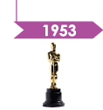
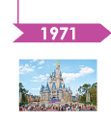
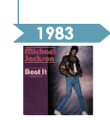
James Watson, Francis Crick and Rosalind Franklin determined that the structure of the DNA molecule is a double helix
The genetic code was cracked, demonstrating that a sequence of three nucleotide bases (a codon) determines each of 20 amino acids.
A technique for making many copies of a specific DNA sequence, the polymerase chain reaction (PCR), was developed
The number of chromosomes in humans was determined to be 46, instead of the widely believed 48
Gel electrophoresis was developed to sequence DNA using an electric current
First human tumor-suppressor genes were discovered
Cancer was linked to damage at cell cycle checkpoints
First Oscars televised
First McDonald’s opened in Des Plaines, IL
Color TV became popular
Disney World opened in Orlando FL
Motorola obtained patent for first mobile phone
Michael Jackson’s “Beat It” topped the charts
First episode of The Simpsons aired
Notes:
Instructor Notes
Once the Timeline of Advances in Cancer Research cards have been arranged and discussed by the classroom groups, go through the innovations and events in this table and discuss to confirm students’ understanding.
In your review of the timeline, ask the group why technology has been so important to learning more about cancer.
DESIGN NOTE: Please create graphic similar to the one on slide.

Slide 9
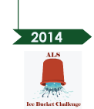
A mutation on BRCA1 gene in 5-10% of women was determined to be linked to cancer, found on chromosome 17
FDA approved three-dimensional
mammography for routine screening as
diagnostic tool for breast cancer
The BRCA1 gene was cloned. People could
now be screened for BRCA1 mutations
Two vaccines (Gardasil and Cervarix)were developed to protect against (HPV-16 & HPV-18) cancer causing viruses
The entire sequence of DNA composing
human chromosomes was completed
Pretty Woman and
Home Alone premiered
Justin Beiber was born
Facebook was founded
The final Harry Potter movie was released
The ALS association raised $115 from the Ice Bucket Challenge
Notes:
Instructor Notes
Once the Timeline of Advances in Cancer Research cards have been arranged and discussed by the classroom groups, go through the innovations and events in this table and discuss to confirm students’ understanding.
In your review of the timeline, ask the group why technology has been so important to learning more about cancer.
DESIGN NOTE: Please create graphic similar to the one on slide.

Slide 10
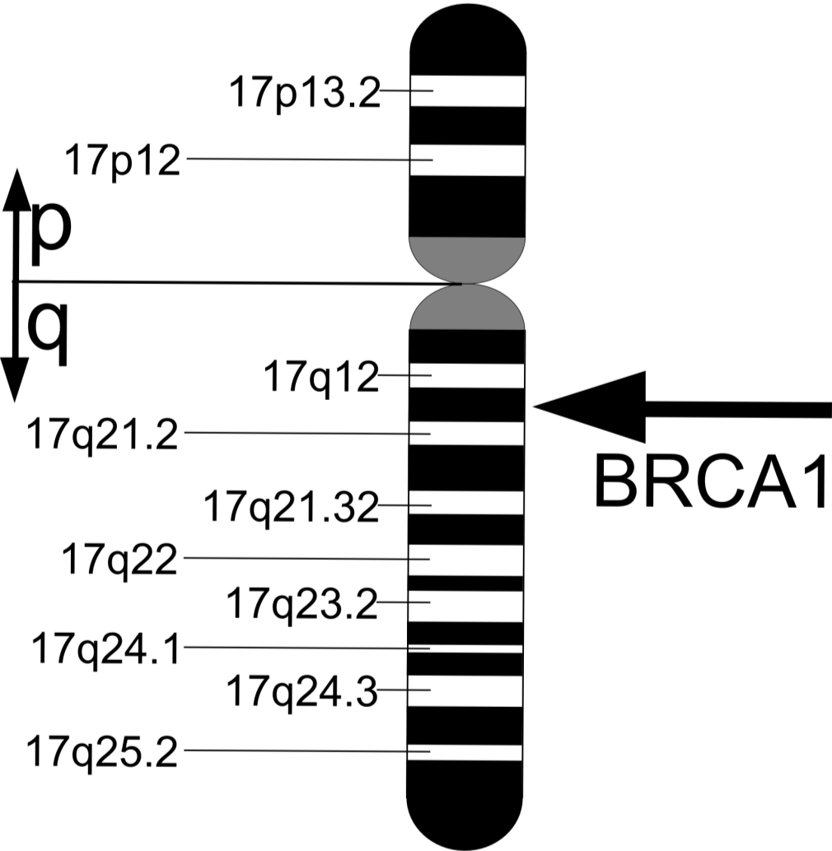
Chromosome 17
BRCA1 (BReast CAncer gene 1) was first described in 1990 and isolated in 1994.
Notes:
Instructor Notes
Tell the the class what BRCA1 is, when it was discovered, and what it indicates, including the following:
BRCA 1 is associated with early-onset breast cancer, ovarian cancer, and fallopian tube cancer
BRCA 1 is also linked to male breast cancer, pancreatic cancer, melanoma, and early-onset prostate cancer
Designer Notes: Possibly use Newsweek breast cancer cover

Slide 11
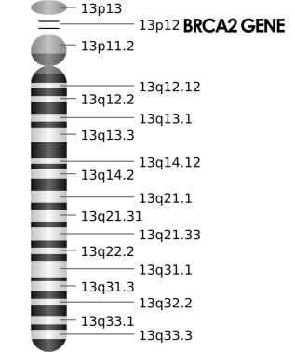
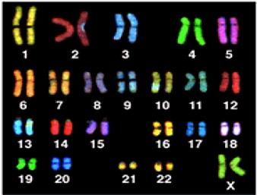
BRCA2 was isolated in late 1994.
Notes:
Instructor Notes
Tell the the class what BRCA2 is, when it was discovered, and what it indicates, including:
BRCA 2 is associated with breast cancer, male breast cancer, ovarian cancer, fallopian tube cancer, prostate cancer, melanoma, and pancreatic cancer.

Slide 12
tumor suppressor genes
BRCA1 and BRCA2 are _________________________, normally expressed in cells of breast and other tissue.
Notes:
Instructor Notes
Use these next set of slides to allow for student engagement.
Learning Activity: Fill-in-the-blanks
Call on individual students to fill in the blanks or ask the class as a whole to answer with their best guess.
DESIGN NOTE: Slides 9-12 should be animated so that there is a blank and a line where the text in red is on the first slide, and the answer filled in on the second slide. This should be a scrolling fill-in-the-blank.

Slide 13
Both genes play an important role in repair of __________________________.
DNA double strand breaks
Notes:
Instructor Notes
Use these next set of slides to allow for student engagement.
Learning Activity: Fill-in-the-blanks
Call on individual students to fill in the blanks or ask the class as a whole to answer with their best guess.
DESIGN NOTE: Slides 9-12 should be animated so that there is a blank and a line where the text in red is on the first slide, and the answer filled in on the second slide.

Slide 14
These genes themselves are normal. _____________ of these genes are abnormal.
Mutations
Notes:
Instructor Notes
Use these next set of slides to allow for student engagement.
Learning Activity: Fill-in-the-blanks
Call on individual students to fill in the blanks or ask the class as a whole to answer with their best guess.
DESIGN NOTE: Slides 9-12 should be animated so that there is a blank and a line where the text in red is on the first slide, and the answer filled in on the second slide.

Slide 15
There are approximately _________________________ of BRCA1 and BRCA2.
2,000 known mutations
Notes:
Instructor Notes
Use these next set of slides to allow for student engagement.
Learning Activity: Fill-in-the-blanks
Call on individual students to fill in the blanks or ask the class as a whole to answer with their best guess.
DESIGN NOTE: Slides 9-12 should be animated so that there is a blank and a line where the text in red is on the first slide, and the answer filled in on the second slide.

Slide 16
When you bake a cake, you follow a recipe in a cookbook. DNA is like your body’s cookbook; DNA is read, resulting in proteins.
However, sometimes there can be mistakes in the cookbook.
Notes:
Instructor Notes
Explain to students how DNA is like a cookbook for your body.
DESIGN NOTE: Photo found here: http://www.istockphoto.com/photo/birthday-cake-vertical-83433?st=ac49b8d

Slide 17
There can be substitutions, where one ingredient is listed instead of another.
Some substitutions, like using applesauce instead of oil, do not have a big effect.
Notes:
Instructor Notes
Tell students that in some cases, substitutions for “ingredients” can be okay, and in other cases, they can be negative.
DESIGN NOTE: Photos found here:
http://www.istockphoto.com/photo/bottle-with-oil-45094498?st=4950a1a
http://www.istockphoto.com/photo/broccoli-14988811?st=7921f9c
http://www.istockphoto.com/photo/white-ceramic-dish-of-apple-sauce-on-white-65235253?st=001d183

Slide 18
Other substitutions, such as using broccoli instead of oil, do have a big effect.
Notes:
Instructor Notes
Tell students that in some cases, substitutions for “ingredients” can be okay, and in other cases, they can be negative.
DESIGN NOTE: Photos found here:
http://www.istockphoto.com/photo/bottle-with-oil-45094498?st=4950a1a
http://www.istockphoto.com/photo/broccoli-14988811?st=7921f9c
http://www.istockphoto.com/photo/white-ceramic-dish-of-apple-sauce-on-white-65235253?st=001d183

Slide 19
Similarly, DNA bases may substitute for other bases, with minor or major changes to proteins.
There can also be too much of an ingredient—DNA bases can be duplicated.
Notes:
Instructor Notes
Help students connect the cake recipe analogy to the DNA “recipe” for students: DNA bases can be substituted or can be missing. This changes the functions of proteins.
DESIGN NOTE: Photo found here: http://www.istockphoto.com/photo/birthday-cake-vertical-83433?st=ac49b8d

Slide 20
Also, one or more ingredients may be missing, which can seriously affect the cake. For example, if you do not add yeast, the cake will not rise.
Notes:
Instructor Notes
Help students connect the cake recipe analogy to the DNA “recipe” for students: DNA bases can be substituted or can be missing. This changes the functions of proteins.
DESIGN NOTE: Photo found here: http://www.istockphoto.com/photo/birthday-cake-vertical-83433?st=ac49b8d

Slide 21
If one or several bases are missing from DNA, the protein will not function properly.
Since BRCA1 and BRCA2 are tumor suppressor genes, any changes to the recipe can mean the resulting proteins will perform this function less effectively.
Notes:
Instructor Notes
Connect the cake recipe analogy to the DNA “recipe” for students: DNA bases can be substituted or can be missing. This changes the functions of proteins.
DESIGN NOTE: Photo found here: http://www.istockphoto.com/photo/birthday-cake-vertical-83433?st=ac49b8d . Need to add one line to the KEY in the image: U = uracil

Slide 22
The DNA code is the original recipe that controls cell activities.
The code is transcribed into an RNA code.
Both the DNA and RNA codes are arranged into codons composed of three bases each.
On RNA, Adenine binds Uracil (A à U) because Thymine is not present in RNA
The code is then translated at the ribosome into an amino acid code, which makes up the protein (the cake).
Notes:
Instructor Notes
Explain how the DNA “recipe” works. Emphasize the difference between the key terms TRANSCRIPTION and TRANSLATION and their role in the creation of proteins.
DESIGN NOTE: Please create a basic graphic showing the steps in the recipe:
DNA code >>(transcription)>> RNA code >>(translation) >> amino acid code >> protein
-------------------( RECIPE )----------------------- ----------CHEF----------- CAKE

Slide 23
Let’s explore a common BRCA1 mutation: 187delAG
The mutation name provides information about its effect on the DNA sequence:
187 The mutation starts at nucleotide position 187
del The mutation is a deletion
AG The nucleotides A and G are deleted
Notes:
Instructor Notes
Provide handouts of BRCA1 and BRCA2 proteins, several copies of the Genetics Mutations worksheet, and the Codon Chart. Review the Genetic Mutations worksheet with the class. You can complete the worksheets as a class or divide students into small groups to complete it together.

Slide 24
First, examine the transcription and translation of the normal (non-mutated) sequence. Begin by looking at the BRCA1 DNA sequence.
Locate line 181 in the sequence. On the Genetic Mutations worksheet, write down the first seven codons on Line 181 to get the coding strand DNA (Sense Strand).
BRCA 1 DNA Sequence (Excerpt)
181st nucleotide
187th nucleotide
Notes:
Instructor Notes
Take students through the steps of identifying the nucleotides and codons affected by the mutation 187delAG. Each letter in the sequence is one nucleotide; in the sequence, they arranged into 20 codons per line (60 nucleotides).
Count from the beginning of the line (nucleotide 181) to find the 187th nucleotide.
Coding Strand DNA (Sense Strand): The correct result is as follows: 5’GGT AGT AGA GTC CCG GGA AAG 3’

Slide 25
Base Pair Replication Key
Guanine | → | Cytosine
Cytosine | → | Guanine
Adenine | → | Thymine
Thymine | → | Adenine
The anti-sense strand is a mirror image of the sense strand, completing the base pair for mRNA to read.
Replicate the normal coding strand DNA sequence into template DNA anti-sense strand. Use the key on the right to help you.
Replication: Sense Strand to Anti-Sense Strand
The coding strand DNA (sense strand)…
ggt | agt | aga | gtc | ccg | gga | aag
…is replicated into its mirror image, the template strand (anti-sense strand):
cca | tca | tct | cag | ggc | cct | ttc
Notes:
Instructor Notes
Take students through the second step in the sequence: Find the “mirror image” for each nucleotide in the Sense Strand to complete the base pair and complete the Anti-Sense Strand.
Begin one nucleotide at a time starting with the first codon:
G→C
G→C
T→A
Then collaborate with the class to finish the entire anti-sense strand sequence.
The correct sequence is as follows:
Coding Strand DNA (Sense Strand): 5’GGT AGT AGA GTC CCG GGA AAG 3’
Template Strand DNA (Anti-Sense Strand): 3’CCA TCA TCT CAG GGC CCT TTC 5’
mRNA: 5’ GGU AGU AGA GUC CCG GGA AAG ‘3
DESIGN NOTE: The last two lines of the table at the bottom of this screen should be separated out so each cell can be filled in as students replicate the sequence, one cell at a time.

Slide 26
Transcription: Anti-Sense Strand to mRNA
Cytosine | → | Guanine
Guanine | → | Cytosine
Adenine | → | Uracil
Thymine | → | Adenine
Next, transcribe your anti-sense strand into mRNA. Remember that RNA uses uracil (U) instead of thymine (T).
Transcription: Anti-Sense Strand to mRNA
Sense Strand:
ggt | agt | aga | gtc | ccg | gga | aag
Anti-Sense Strand:
cca | tca | tct | cag | ggc | cct | ttc
mRNA Transcription:
ggu | agu | aga | guc | ccg | gga | aag
Notes:
Instructor Notes
Now use the key to take students through the transcription of the Anti-Sense Strand into an mRNA sequence. This is how the mRNA “reads” the code and translates it to synthesize a protein.
Remember that mRNA uses uracil (U) instead of thymine (T).
The correct sequence is as follows:
Coding Strand DNA (Sense Strand): 5’GGT AGT AGA GTC CCG GGA AAG 3’
Template Strand DNA (Anti-Sense Strand): 3’CCA TCA TCT CAG GGC CCT TTC 5’
mRNA: 5’ GGU AGU AGA GUC CCG GGA AAG ‘3
DESIGN NOTE: The last two cells of the bottom table should start empty so students can fill it in as a class, one cell at a time, only showing the solution when they’re finished.

Slide 27
Use the Codon Chart to translate the normal mRNA sequence into amino acids.
mRNA: 5’ GGU AGU AGA GUC CCG GGA AAG 3’
Translate the first codon. Begin with the inside of the chart and work your way out:
GGU
Glycine
Notes:
Instructor Note:
Explain how to use the codon chart: Start on the inside of the chart with the first base, then work your way outward until you have completed the nucleotide. For example, the first codon in the mRNA sequence, GGU, translates to Glycine.
Codon chart source: http://genetics100.weebly.com/uploads/3/0/4/3/30436776/4765376.jpg?376
DESIGN NOTE: If necessary, please replicate the above codon chart.

Slide 28
Now complete the translation of all the codons in the normal sequence:
mRNA Codon | Amino Acid
GGU | glycine
AGU | serine
AGA | arginine
GUC | valine
CCG | proline
GGA | glycine
AAG | lysine
Notes:
Instructor’s Note:
Use the codon chart to complete the translation of the mRNA sequence into an amino acid sequence to complete the resultant protein. The final protein resulting from the normal gene is as follows:
Amino Acids: Glycine Serine Arginine Valine Proline Glycine Lysine
Tell students that this is the final protein, and next they will perform the same sequence to explore the mutated gene.
Codon chart source: http://genetics100.weebly.com/uploads/3/0/4/3/30436776/4765376.jpg?376

Slide 29
Now apply the mutation 187delAG to the normal sequence. Remember the meaning of the mutation:
187 The mutation starts at nucleotide position 187
del The mutation is a deletion
AG The nucleotides A and G are deleted
Remove the AG nucleotides starting at position 187 so the coding strand sequence reads as shown above.
Record the new sense strand in your genetic mutations worksheet:
ggt agt agt ccc ggg aaa g
Notes:
Instructor Notes
Begin with the same process as before: Step 1 is to identify the affected line of the sequence (line 181, first 7 codons).
Then count up to the 187th nucleotide and remove AG.
Mutated Coding Strand DNA (Sense Strand): The correct result is as follows: 5’ GGT AGT AGT CCC GGG AAA G 3’

Slide 30
2. Base Pair Replication Key
Guanine | → | Cytosine
Cytosine | → | Guanine
Adenine | → | Thymine
Thymine | → | Adenine
Use the same process to replicate the mutated coding strand DNA sequence into template DNA (anti-sense strand).
Then transcribe your anti-sense strand into mRNA.
BRCA1: 187delAG Mutated DNA and mRNA Sequence
Sense Strand | ggt | agt | agt | ccc | ggg | aaa | g
Anti-Sense Strand | cca | tca | tca | ggg | ccc | ttt | a
mRNA Sequence | ggu | agu | agu | ccc | ggg | aaa | g
3. Transcription: Anti-Sense Strand to mRNA
Cytosine | → | Guanine
Guanine | → | Cytosine
Adenine | → | Uracil
Thymine | → | Adenine
Notes:
Instructor Notes
Now take students through steps 2 and 3:
2. Replicate the mutated coding strand, completing the base pairs to find the anti-sense strand.
3. Transcribe the anti-sense strand into mRNA (using uracil instead of thymine to pair with adenine).
The correct sequence is as follows:
Coding Strand DNA (Sense Strand): 5’GGT AGT AGT CCC GGG AAA G 3’
Template Strand DNA (Anti-Sense Strand): 3’CCA TCA TCA GGG CCC TTT C 5’
mRNA: 5’ GGU AGU AGU CCC GGG AAA G

Slide 31
Now complete the translation of all the codons for the mutated gene:
mRNA Codon | Amino Acid
GGU | glycine
AGU | serine
AGU | serine
CCC | proline
GGG | glycine
AAA | lysine
G | ---
Notes:
Instructor Notes
Use the codon chart just as before to translate the mutated mRNA codons into the amino acid sequence.
Mutated Amino Acids: Glycine Serine Serine Proline Glycine Lysine
Codon chart source: http://genetics100.weebly.com/uploads/3/0/4/3/30436776/4765376.jpg?376

Slide 32
What effects do you observe as a result of the mutation?
The mutated amino acid sequence has been changed and shortened. The resulting protein will also be shortened (truncated) and may not function properly.
Normal Amino Acid Sequence | Mutated Amino Acid Sequence
glycine | glycine
serine | serine
arginine | serine
valine | proline
proline | glycine
glycine | lysine
lysine | ---
Notes:
Instructor Notes
Ask the class what effects they observed as a result of the mutation. Note that compared to the normal BRCA1 protein, the amino acid sequence has been changed and shortened. The resulting protein will also be shortened (truncated) and may not function properly.

Slide 33
Certain population groups have been found to commonly share specific mutations of BRCA genes. These are called founder mutations.
Use the same process to compare the normal and mutated versions of the BRCA genes in the table below:
Example Founder Mutations Identified in BRCA1 & BRCA2
Population | BRCA1 Mutation | BRCA2 Mutation
African-Americans | 1832del5 | 1536del4
Ashkenazi Jews | 5382insC | 6174delT
British | 418del4
Dutch |  | 5579insA
Filipinos |  | 4265delCT, 4859delA
Icelanders |  | 6174delT
Italians | 5083del19
Norwegians | 1135insA, 1675delA
Notes:
Instructor Notes
Tell students that some populations historically have experienced common BRCA mutations. Choose a founder mutation from the table below. Use the BRCA1 and BRCA2 Sequence handouts to find the mutated amino acid sequence for your chosen BRCA mutation. Ask students what they observe in the protein resulting from this mutation.
Learning Activity: Small Groups (10 minutes)
Distribute the BRCA1 and BRCA2 DNA Sequence handouts. Note the sequences in the handouts are abbreviated from the complete nucleotide sequence.
Assign each group 2-3 mutations from the table to investigate, not including the Ashkenazi Jews mutation that was just analyzed. (You may also allow groups to choose their mutation to analyze.) Some mutations may not list the bases that are deleted. For example, in the BRCA2 mutation 1536del4, four bases are deleted, beginning at position 1536. Also, some mutations are insertions. For example, in the BRCA1 mutation 1136insA, an A is inserted at the 1136th position.
Learning Activity Option:
If classroom time is running short, assign this activity as homework. Have each student choose 1-2 mutations to investigate and compare with the normal version of the gene. Tell them to come prepared to show the differences between the normal and mutated gene and discuss the possible effects of these differences.e

Slide 34
What do you know about genetic counseling?
What is its purpose?
What information do genetic counselors use to make recommendations?
Notes:
Instructor Notes
Learning Activity: Discussion
Ask students if they have ever heard of genetic counselors using the questions as a guide. Record students’ preconceptions on a board or overhead. When finished, advance to the next slide.
DESIGN NOTE: Photo found here: http://www.istockphoto.com/photo/young-female-doctor-talking-to-senior-couple-19016467?st=d007b55

Slide 35
GENETIC COUNSELORS
Trained health professionals in medical genetics and counseling
Discuss genetic testing with patients and help them make the right decisions for them
Explain genetic test results and offers support to patients and their families
CANCER GENETIC COUNSELORS
Provide education, risk assessment, and genetic counseling related to cancer risk
Information is based on family history, medical and environmental factors, lifestyle, and in some cases reproductive history.
Teach patients about risk factors for cancer, inheritance of cancer risk, genetic testing, and management options
Notes:
Instructor Notes
Tell students that genetic counselors are trained health professionals in areas of medical genetics and counseling. They discuss genetic testing with patients and help patients make decisions that are right for them. If a patient decides to get a genetic test, the genetic counselor explains the test results with the patient and their family, as well as offers support.
Cancer genetic counselors discuss a patient’s specific cancer risk factors and family history of cancer. They provide education, risk assessment, and genetic counseling. The information is based on a patient’s family history, medical factors, environmental factors, reproductive history and lifestyle choices. Patients learn about different risk factors for cancer, the inheritance of cancer risks, genetic testing, and management options through a genetic counselor.

Slide 36
Steve’s parents visited the genetic counselor, Mr. Even Smith, to talk about genetic tests associated with cancer.
They told Steve and Nikki that Evan is happy to answer any questions they have for him.
Steve decided to write him an e-mail with his questions.
Notes:
Set up the scenario that Steve and Nikki’s parents went to an appointment with a genetic counselor to discuss cancer risk factors and the possibility of getting genetically tested. Then proceed to Steve’s e-mail on the next slide.

Slide 37
Discuss
How would YOU respond to Steve?
What information should he include in his family tree?
Dear Mr. Smith,
Mom and Dad were saying that her cancer might have been genetic. Does that mean I can have this gene? Mom said our family history will help her decide if she should get a genetic test for a breast cancer gene. When we did genetics in school my teacher said mutations can be passed on. I’ve never even thought about my family tree. How exactly should it work? What exactly do I have to find out to fill out the tree? Steve
Notes:
Instructor Notes
A model answer is on the next slide (in the response letter from the genetic counselor).
Learning Activity: Think-Pair-Share Email
Divide the class into small groups (2-3) and have students brainstorm responses to Steve’s email. Ask each group to organize their thoughts and decide how they would respond to Steve. Assign roles, such as recorder, if needed. Do not be too concerned about what students write at this point. This is meant to be an open-ended activity to assess students’ preconceptions about cancer.

Slide 38
Dear Steve, Your mom was right—in fact your parents are where all your genes come from. Your parents got their genes from your grandparents, your grandparents from your great grandparents, and so on. Because some cases of breast cancer are due to a genetic mutation, it’s important to know if you have a family history of cancer before deciding to do genetic testing. Here are some things you might want to find out if you’re interested in this: (1) History of cancer in the family and number of generations affected (go all the way back to your great grandparents); (2) Types of cancer present; (3) Age of cancer diagnosis; (4) Multiple cancers in one generation; (5) Other causes of death; and (6) Current age or age of death. Can you help your mom get this info for me?
Sincerely, Evan Smith, MS, Licensed Genetic Counselor
Notes:
Instructor Notes
This is a sample response from Genetic Counselor Ms. Evelyn Smith. Ask students to compare their responses to this one. What else should they include?
Go over the important information in a family pedigree for beginning to analyze a family’s cancer risk:
History of cancer in the family and number of generations affected (If cancer is found in every generation, there is a greater possibility that a genetic mutation is present.)
Types of cancer present (Certain genetic mutations are associated with more than one type of cancer. For example, BRCA2 mutations cause increased risk of breast and ovarian cancer in women and breast and prostate cancer in males. Therefore, if these types of cancer are present in one family, there may be a BRCA mutation present.)
Age of cancer diagnosis (Since the main risk factor for cancer is age, a diagnosis of cancer before age 50 strongly suggests there may be a inherited genetic mutation present.)
Multiple cancers in one generation
Other causes of death
Explore:
Note to students that not all cases of breast cancer are due to an inherited mutation. Only 5-10% of breast cancer is inherited. Scientists don’t know what causes the other 90%. Most cancer may be the result of environmental exposures, other genes or a combination of both.

Slide 39
I got the following information from Mom’s side of the family for the family history:
For Mom’s brother – Uncle Dave is 41. He’s married to Aunt Val who’s 42. They have two daughters – Kim, 8 and Diana, 6. None of them has cancer.
For Mom’s sister – Aunt Linda is 39. She is married to Uncle Bill who’s 40. Their baby Jacob is 2. They are all fine, too – no one has cancer.
Mom’s mother, Nana Rose, is 76 and I just learned she had breast cancer when she was 62. Nana’s sisters are 74 and 70 and there’s no cancer.
Mom’s dad, Papa Sam, is 75 and he had prostate cancer at 68. His brother died at age 77 and got lung cancer at 68.
Notes:
Instructor Notes Show Nikki’s Family History Notes and explain to students they will be using them to complete a pedigree for the Williams family.

Slide 40
My great grandparents died when Steve and I were little so I don’t remember them.
For Nana’s parents – her dad died at age 68 of a stroke and her mom died at 72 and also had breast cancer at 69.
For Papa’s parents – his dad died at age 71 of a heart attack and his mom died at 74 of Alzheimer’s.
So I guess the next step is to create one of these family pedigrees to chart all this, but I’m not sure how.
Notes:
Instructor Notes Show Nikki’s Family History Notes and explain to students they will be using them to complete a pedigree for the Williams family.

Slide 41
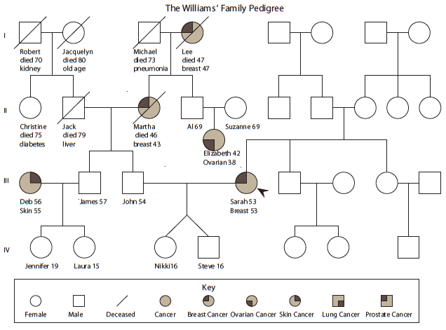
Complete Sarah’s side of the Williams family pedigree.
Notes:
Instructor Notes
Class Activity: Tell students they will use the information in Nikki’s Family History Notes on the previous slide to complete Sarah’s side of the Williams Family Pedigree.
Review pedigrees and how to complete them, if necessary. Distribute a copy of the incomplete Williams Family Pedigree and ask students to fill in the missing information in small groups or as a class. As a class, discuss relevant information from the incomplete Williams Family Pedigree worksheet, including the following:
History of cancer in the family and number of generations affected (If cancer is found in every generation, there is a greater possibility that a genetic mutation is present.)
Types of cancer present (Certain genetic mutations are associated with more than one type of cancer. For example, BRCA2 mutations cause increased risk of breast and ovarian cancer in women and breast and prostate cancer in males. Therefore, if these types of cancer are present in one family, there may be a BRCA mutation present.)
Age of cancer diagnosis (Since the main risk factor for cancer is age, a diagnosis of cancer before age 50 strongly suggests there may be a inherited genetic mutation present.)
Multiple cancers in one generation
Other causes of death

Slide 42
Work with your group to analyze the Williams Family Pedigree using the questions on the next slide.
Notes:
Instructor Notes
Divide students into small groups and introduce the activity. Students will work together to answer the questions on the next slide.

Slide 43
How many generations are shown in the pedigree?
What does the pedigree reveal about the family’s history of breast cancer?
If someone has a mutated BRCA gene, does that mean they have or will have breast cancer? Why?
BRCA mutations are dominant. Who could potentially have an inherited BCRA mutation? Why?
Notes:
Instructor Notes
Divide students into small groups and introduce the activity. Students will work together to answer the questions on the next slide.

Slide 44
Try to create your own family pedigree using a site like My Family Health Portrait.
Notes:
Instructor Notes
Homework Assignment: Tell students they will use information from their family to create a family pedigree, or family health history, using a site like My Family Health Portrait. Located at https://familyhistory.hhs.gov/FHH/html/index.html
Explain to students that this exercise is to help them build understanding of the kinds of information that can be important for family members to know, but they will NOT be required or asked to submit their pedigrees for review. Explain that their family pedigree may help them make decisions about their health now and in the future, but they are private.

Slide 46
Sample Family Pedigree
Notes:
Instructor Notes
Begin a discussion of the homework assignment—using the family health history tool to create and explore students’ own family history.
Reflection and discussion questions:
What kinds of information is it important to know before building a family pedigree or health history?
Did anything surprise you about this process?
How many generations were you able to find information about? What was challenging about this?
Note: Be careful not to ask students to share personal or family health information. The purpose of the activity is exploration of the tool, not the specific results of any one student’s search.
DESIGN NOTE: Include sample family tree graphic on right.

Slide 47
GENETIC COUNSELORS
Trained health professionals in medical genetics and counseling
Discuss genetic testing with patients and help them make the right decisions for them
Explain genetic test results and offers support to patients and their families
CANCER GENETIC COUNSELORS
Provide education, risk assessment, and genetic counseling related to cancer risk
Information is based on family history, medical and environmental factors, lifestyle, and in some cases reproductive history.
Teach patients about risk factors for cancer, inheritance of cancer risk, genetic testing, and management options
Notes:
Instructor Notes
Review the information from day 1 on who genetic counselors are and what they do. Then proceed to set up the role play activity in the following slides.

Slide 48
Collect a detailed personal medical and family history
Perform a cancer risk assessment
Discuss the implications of genetic testing
Discuss potential medical management options
Discuss genetic testing process
Notes:
Instructor Notes
Share the following additional detail with students:
Collect a detailed personal medical and family history
Perform a cancer risk assessment
Discuss the implications of genetic testing for the individual and the family
Identify the most appropriate person to test in the family
Discuss potential medical management options
For the patient and the family
Discuss genetic testing process
Ordering the test
Insurance Preauthorization
Informed Consent
DESIGN NOTE: Photo found here:stock-photo-49270402-consultation-of-clinician

Slide 49
What is a genetic counseling session like? Let’s find out.
Choose a partner to role play a simulated cancer genetic counseling session.
Notes:
Instructor Notes
Explain to students that they will experience a genetic counseling session to learn more about the risks and genetics of breast cancer and to see what a genetic counseling session is like.
Learning Activity: Divide students into pairs and distribute the Genetic Counseling Script to each student. Once students have chosen their roles and are familiar with the script, allow time for each pair to role-play the genetic counseling session. Debrief the role play by asking students to share their thoughts about the role of genetic counselors in cancer diagnosis and treatment.
Option 1: Have a 3rd student in each group whose job it is to draw the patient’s family tree while the other two discuss it verbally in the role play script.
Option 2: Have one pair of students conduct the role-play for the class. The rest of the students should listen closely and sketch a family tree for the patient based on his or her responses to the genetic counselor’s questions in the role play.
Debrief the activity with students once all pairs have finished. Have students share their family tree sketches and determine whether students came up with the same basic tree. Assess whether any of their preconceptions about genetic counseling have changed.
Advise students that they will be doing a homework assignment related to genetic counseling.
DESIGN NOTE: Photo found here: http://www.istockphoto.com/photo/doctor-explaining-an-illness-to-his-patient-41887766?st=79cd3f0

Slide 50
Assume the role of a genetic counselor and write a letter to Mr. and Mrs. Williams.
Notes:
Instructor Notes
Distribute the Patient Letter Template and the Genetic Counseling Script to students for their homework assignment. Review the template and answer any student questions about the assignment.
Homework Assignment: Tell students that after a genetic counseling session, the counselor writes a letter to the patient. The purpose of the letter is to summarize the session so the patient has a written record of what was discussed. Tell students they will assume the role of a genetic counselor and write a letter to Mr. and Mrs. Williams regarding whether or not they should be tested based on the Williams’ pedigree. Students should include their recommendation for both parents and provide at least two to three reasons for their choice in the letter. Students should also address the pros and cons of getting tested. A Sample Patient Letter is provided.
DESIGN NOTE: Photo found here: http://www.istockphoto.com/photo/doctor-at-work-35790526?st=b297968

Slide 51
Well, after the genetic counseling session, both Mom and Dad decided to get tested, since they both had some cancer in their family history. They were even able to use the pedigree we put together during the counseling session!
I wonder what the test will be like. How do they look at the genes?
Notes:
Instructor Notes
Learning Activity: Small Group Brainstorm
Divide the class into small groups and have students brainstorm their thoughts about Nikki’s question. Ask each group to organize their thoughts and decide how they will answer Nikki’s questions. Assign roles, such as recorder, if needed. Do not be too concerned about what students write at this point. This is meant to be an open-ended activity to assess what student know about genetics and cancer.

Slide 52
Analysis of human DNA, RNA, chromosomes, proteins, or certain metabolites to detect alterations in genes
Today, automated DNA sequencing instruments are used to analyze BRCA1 and BRCA2
Historically, other methods were used such as gel electrophoresis
Gel electrophoresis separates DNA fragments based on size and charge
Notes:
Instructor Notes
Tell students that a genetic test is the analysis of human DNA, RNA, chromosomes, proteins, or certain metabolites in order to detect alterations in genes.
With advances in technology, BRCA1 and BRCA2 are now analyzed with modern automated DNA sequencing instruments. However, historically, genes were analyzed through various methods, including gel electrophoresis.
Gel electrophoresis allows for separation of DNA fragments based on their size and charge.

Slide 53
Gel electrophoresis is a method of genetic testing in which DNA fragments are separated according to size.
Complete the Gel Electrophoresis Virtual Lab
Notes:
Instructor Notes
Tell students they will conduct an interactive simulation gel electrophoresis activity online. Direct students to the Gel Electrophoresis Virtual Lab at http://learn.genetics.utah.edu/content/labs/gel/. The simulation takes approximately 10 minutes to complete. Distribute the Gel Electrophoresis Simulation worksheet, which students can complete as they go through the activity.
Image: photo of lab tech

Slide 54
This activity requires 10 participants.
Each student represents a nitrogenous base of DNA.
The space for the activity represents the “gel.”
Students arrange themselves in 4 rows or “lanes.”
Notes:
Instructor Notes
This activity requires a large space, such as an open room, gym or outside area to represent the “gel.” The area should accommodate 4 rows or “lanes” that students will navigate through. If you plan to conduct the activity in a classroom, use desks or chairs to create lanes. If you plan to conduct the activity outside, mark off lanes with chalk, yarn, or other natural markers, such as trees or rocks.
Tell students they will be doing an activity to explore gel electrophoresis. Review the Gel Electrophoresis Activity supplement for full instructions on this activity.

Slide 55
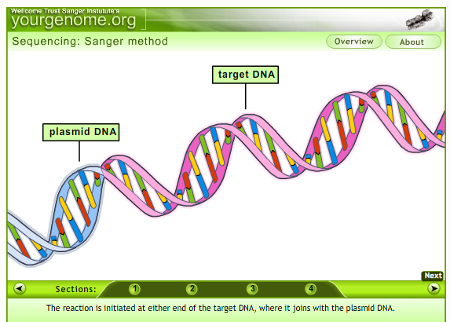
Video: Sanger Sequencing
Notes:
Instructor Notes
This animation shows another method of genetic testing without gel electrophoresis, Sanger sequencing. NOTE: Scroll down to animation and click NEXT to begin.
http://www.yourgenome.org/video/sanger-dna-sequencing
Alternate source: https://www.youtube.com/watch?v=iTBTHmhNNbE

Slide 56
Dear Ms. Smith,
The results came back. Dad is a carrier. Mom does not have a BRCA mutation, but she will start treatment soon. It is a kind of a relief to just know either way. I wonder if Nikki or I should get tested? Or even our cousins, since they share a lot of the same genes?
Steve
Notes:
Instructor Notes
Distribute the genetic test results (2 pages—1 each for John and Sarah). Discuss with students what the results mean and how this affects the cancer risk of the family members in the family tree (John, Sarah, Steve, Nikki, and Jen).
Note that the answer to Steve’s question above is that he, Nikki, and their cousins should not be tested. According to the genetic counselor in the role play activity, it is not recommended to get BRCA gene mutation testing until at least age 25. Steve and Nikki are not at increased risk for cancer while they are still young. If they do decide to pursue genetic testing as adults, they should have the same pre-test counseling process that Sarah and John went through so they understand the implications.
Class Discussion
Ask students what their response would be to Steve’s question.

Slide 57
Review the genetic test results for Mr. and Mrs. Williams.
Discuss the significance of the test results with your group and summarize your findings.
Make a recommendation about whether or not Steve or Nikki should get tested for a BRCA mutation. Keep in mind not only Steve and Nikki’s risk factors but the expense of the testing.
Come up with one to three reasons as to why you made your choice.
Notes:
Instructor Notes
Activity: Think, Group, Share
Divide the class into small groups and have students review the genetic test results for Mr. and Mrs. Williams. Provide copies of the Genetic Test Results to students.
Allow students time to review the test results and summarize their findings. Ask students to discuss the significance of the test results for the different members of the Williams family.
Tell groups they need to make a recommendation about whether Steve or Nikki should get tested for a BRCA mutation. Allow each group time to discuss the issue and come up with one to three reasons as to why they made their choice. Then have a representative from each group share their recommendation and reasons for their recommendation. Compare and discuss the groups’ recommendations.

Slide 58
Notes:
Instructor Notes
Pass out the Lesson 1 Quiz to assess students’ understanding of Lesson 1 objectives.

