Slide 1
Pre-Lesson Prep Assignment
Notes:
Instructor Notes
Pre-lesson prep assignment: One class session before beginning this lesson on Pathology, distribute the Pathology Primer for students to complete for homework. The lesson will begin with reviewing this worksheet/homework assignment.

Slide 2
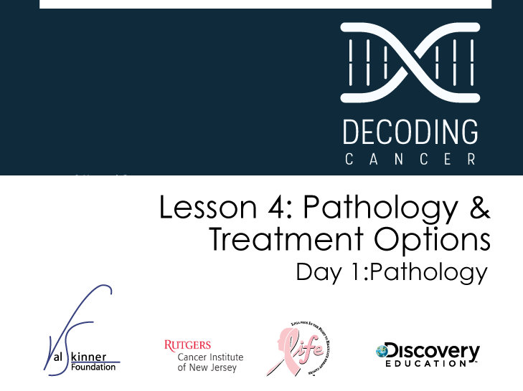
Notes:
Instructor Notes
This lesson covers reading and interpreting pathology reports, understanding treatment options, and designing clinical trials. Day 1 focuses on the importance of pathology reports, what information is included, and how doctors take action based on them.

Slide 3

Upon completion of this lesson, you will be able to:
Discuss the purpose of pathology reports and the
roles of pathologists
Distinguish between different sub-types of breast cancer
Understand how cancers are staged
Read and interpret a pathology report
Identify common misconceptions about cancer
treatment and clinical trials
Graphically organize accumulated knowledge
about cancer
Differentiate between cancer treatment options
Predict treatment plans for patients
Understand the criteria for evaluating the effectiveness
of a new treatment
Design a cancer treatment clinical trial
Notes:
Instructor Notes
Lesson Summary: [TK] Lesson Duration: One 45-60 minute class periods.

Slide 4

Steve and Nikki have heard their parents refer to a pathology report, but they are not sure what it is.
Notes:
Instructor Notes
Share with students that Steve and Nikki are learning more about their mom’s cancer. They are interested in learning about more of the details and want to understand what the pathology report is and how it’s used.

Slide 5

Dad gave me a copy of mom’s pathology report but it doesn’t make any sense to me. I can tell it has a lot of useful information but what is it used for?
How do I read it?
Notes:
Instructor Notes

Slide 6

Notes:
Instructor Notes
Ask students if they have ever watched CSI (Crime Scene Investigation) or other television shows that highlight the work of pathologists. Pathologists are doctors that identify diseases by studying cells and tissues under a microscope. Ask students why pathologists might be important in diagnosing breast cancer (Pathologists can evaluate if there is cancer present, what type of cancer it is and how far it has spread in the tissue.)

Slide 7
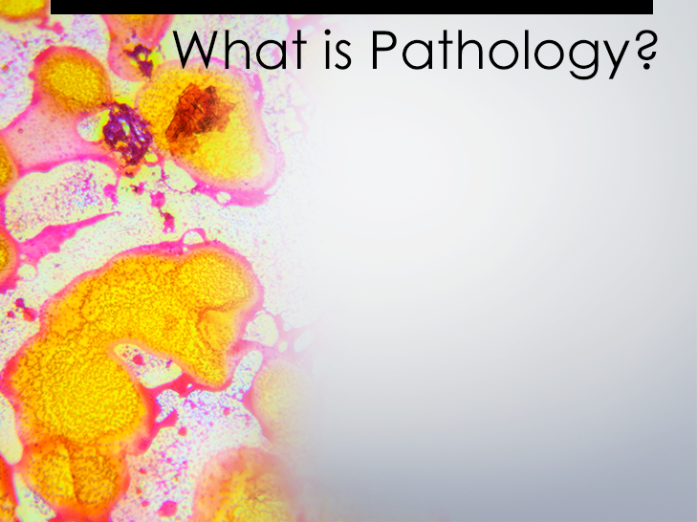
Pathology is the study and diagnosis of diseases in living things by examining tissues, organs, cells, and fluids.
Notes:
Instructor Notes
Tell students that the class will begin this lesson by discussing the Pathology Primer they reviewed for homework prior to the lesson. Ask students to keep their handouts and homework away for the time being and encourage discussion.

Slide 8

Pathologists are doctors who study and diagnose diseases or conditions present in tissues, organs, cells and fluids.
To become a pathologist, a person goes to college for 4 years, medical school for 4 years, and then completes a 4-5 year residency.
Notes:
Instructor Notes
Discuss who pathologists are. This answer is broken into two slides.

Slide 9
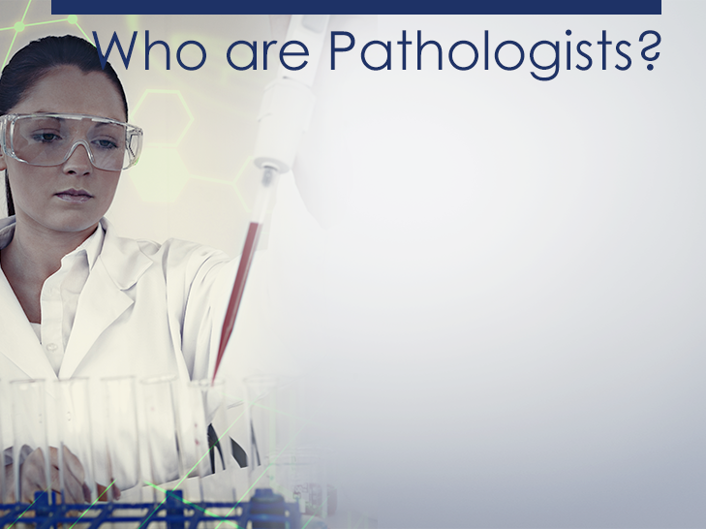
Additional years of study are added if the person wants to specialize in a particular branch of pathology, such as forensics. They generally work in hospitals or medical centers with extensive laboratory equipment.
Notes:
Instructor Notes
This is continued from the previous slide. Explain that forensics is scientific tests used to study crime.

Slide 10

There are two main types of pathologists:
Anatomical; and
Clinical
Notes:
Instructor Notes

Slide 11

Anatomical pathologists study the organs, tissues,
and cells of patients. Examples include:
Autopsy pathologist
Forensic pathologist
Surgical pathologist
Cytopathologists
Notes:
Instructor Notes
Anatomical pathologists study the organs, tissues, and cells of patients. Discuss what these types of pathologists do. Autopsy pathologists and surgical pathologists perform autopsies and study the organs, tissues, and cells. Forensic pathologists work to determine cause of death. Cytologists are technicians, and cytopathologists are the physicians that review and interpret the specimens.

Slide 12

Clinical pathologists study the body fluids of patients, including blood, serum, plasma, urine, respiratory mucous, and cerebrospinal fluid.
Notes:
Instructor Notes
Discuss the difference between anatomical and clinical pathologists.

Slide 13

Pathology reports are written medical documents that describe specimens that were collected by a doctor and sent to a pathologist for analysis. These reports help doctors diagnose a condition so a doctor can prescribe the best course of action to treat a particular disease.
Notes:
Instructor Notes
Discuss what pathology reports are.

Slide 14

Why are pathology reports so important?
For diagnosis
        Tumor grade and stage allows physician to gauge how advanced a cancer is and estimate a patient’s prognosis and inform prescription decisions
        Tumor characteristics (such as the presence of estrogen receptor and progesterone receptor) have important implications for treatment
Notes:
Instructor Notes
Ask students to if they can provide 3 reasons why pathology reports are important.

Slide 15

Describe the role of a pathologist in your own words.
How many years does it take to become a pathologist?
A forensic pathologist belongs to which subdivision of pathology?
What types of fluids are studied by clinical pathologists?
Would you be interested in becoming a pathologist?
Why or why not?
Notes:
Instructor Notes
Tell students to pull out their homework from the night before. Ask for volunteers to share their answers to the homework questions.

Slide 16
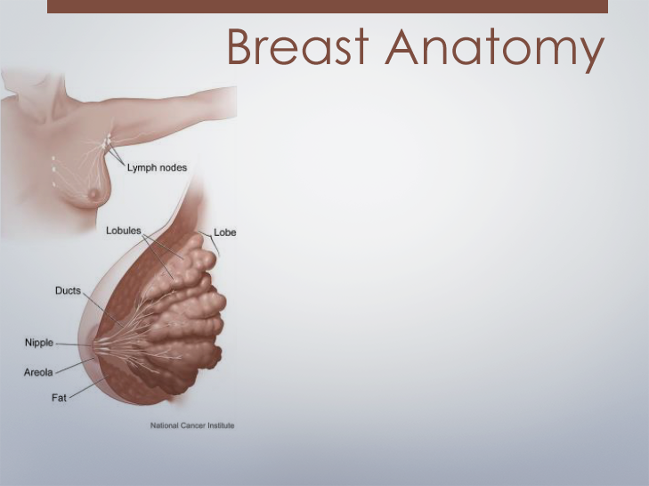
Breast cancer can develop in different parts of the breast—
in the lobules or the ducts which travel from the lobules to the nipple.
Breast cancer that spreads outside the breast may invade nearby lymph nodes.
Notes:
Instructor Notes
Explain that lobular carcinoma occurs in the lobes of the breast while ductal carcinoma occurs in the ducts of the breast.
Suggest handing out Breast Anatomy pg 20 from Lesson 4 BioCONECT

Slide 17

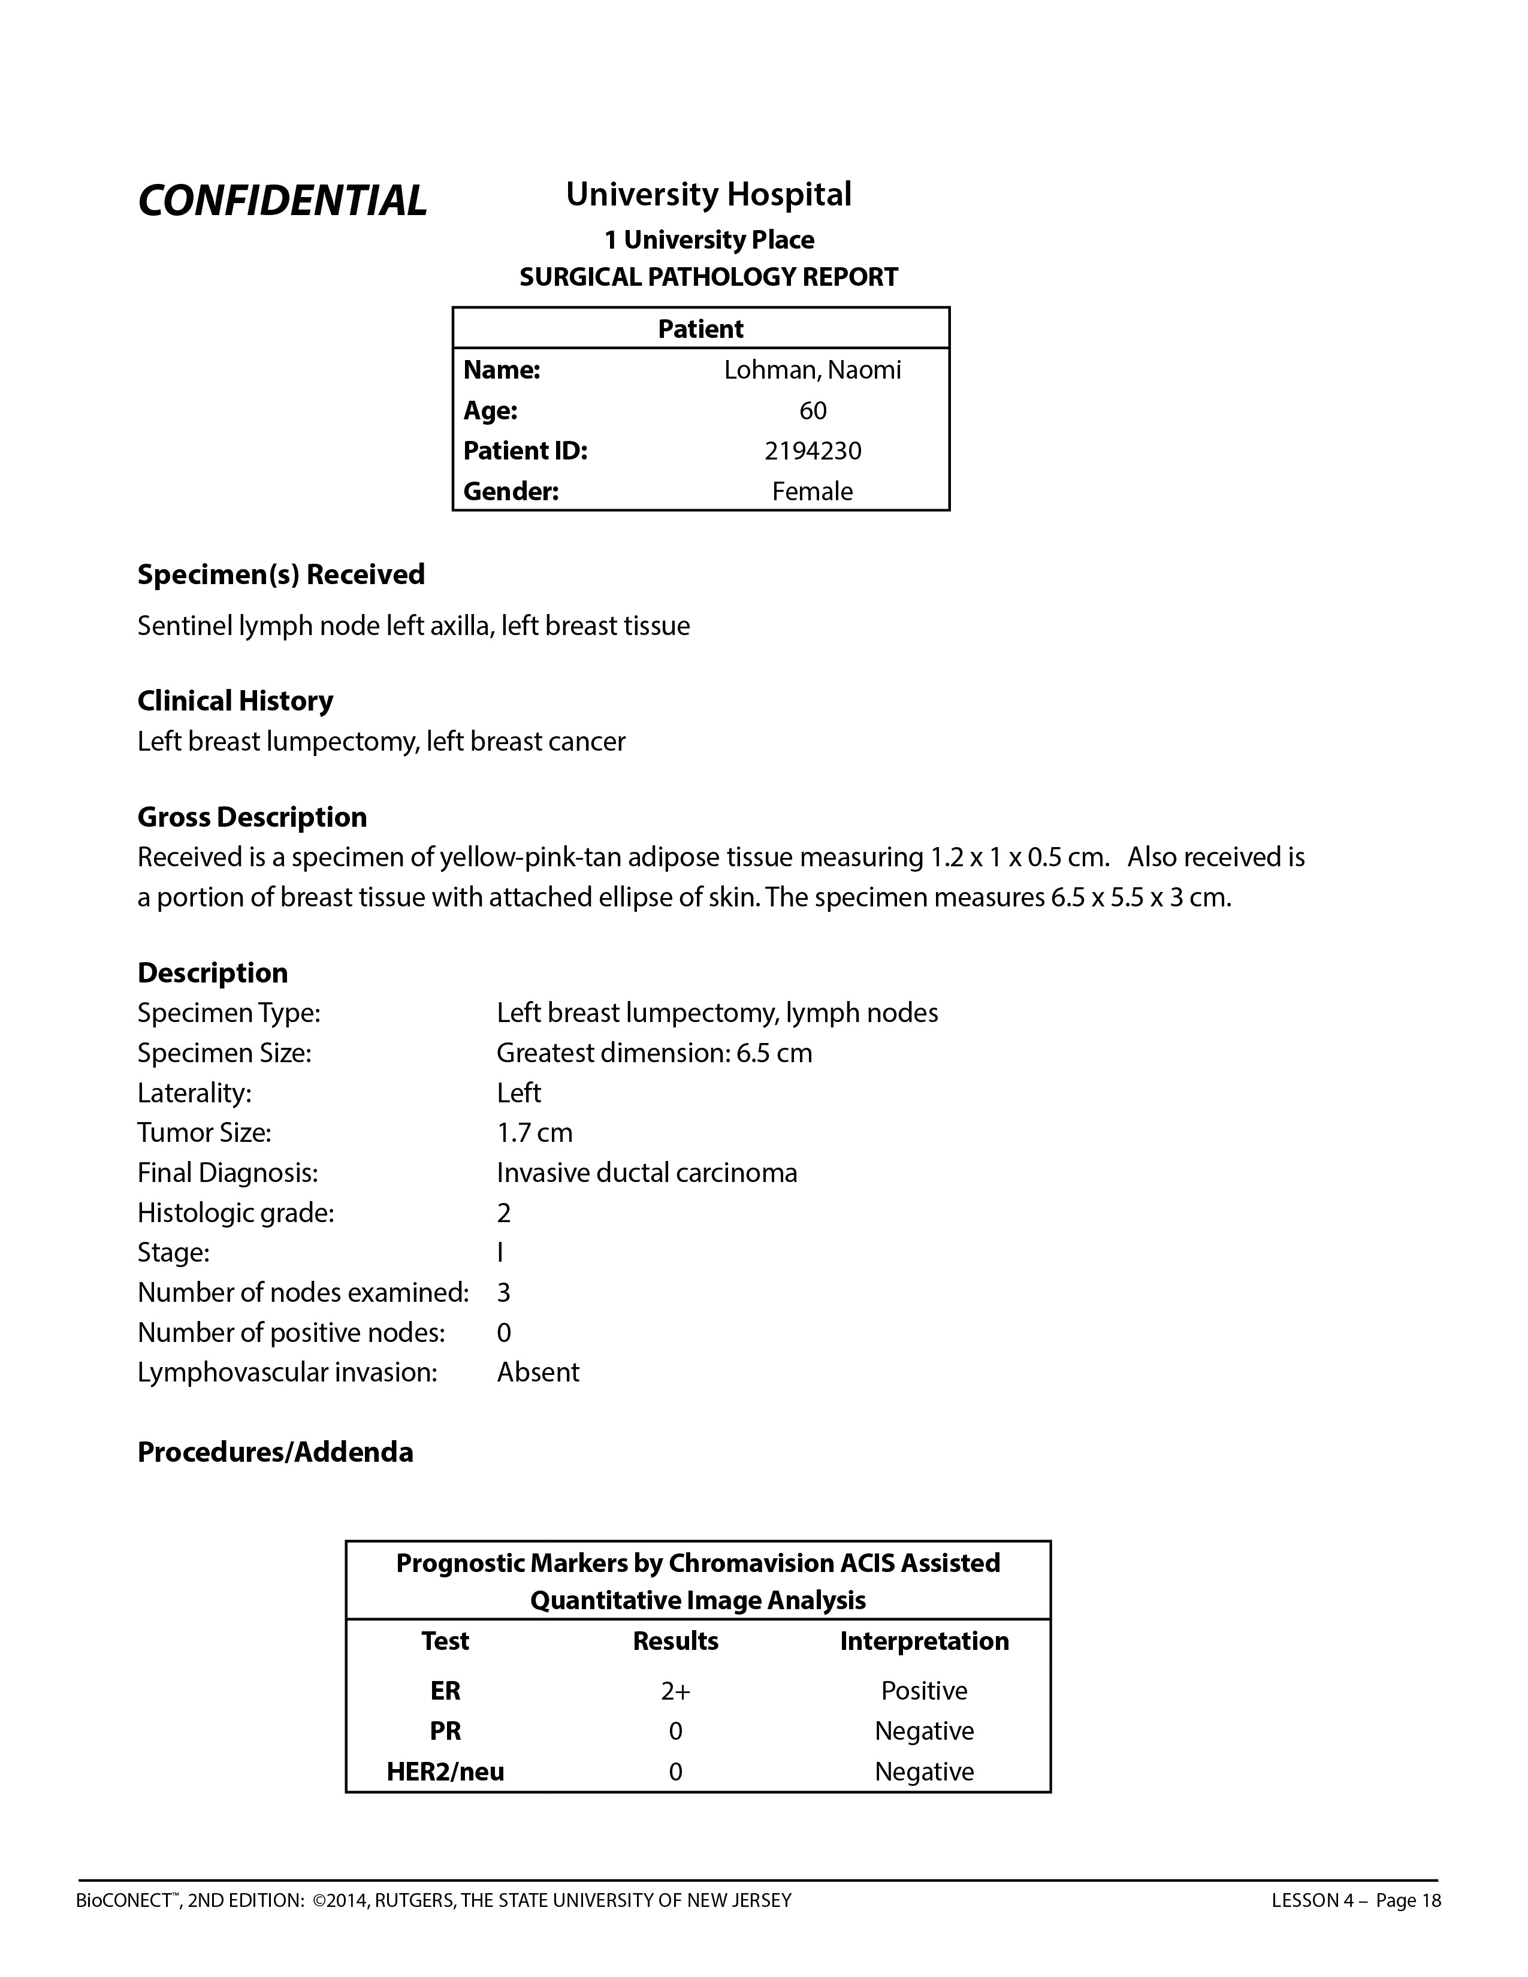
The first information you should look for is the patient's name, age, and gender
This section is a description of what was submitted to the pathologist from the surgeon and what procedure was done to obtain it
These are the tissues that will be examined by a pathologist to establish a diagnosis
This section refers to the patient’s breast cancer history, such as any procedures that have been done and/or a diagnosis
Notes:
Instructor Notes
Slides 18-19 accompany A Guide to Interpreting a Pathology Report and Naomi Lohman Pathology Report. Distribute the handouts for students to reference as you go through these slides.
Distribute Naomi Lohman Pathology Repot and A guide to interpreting a pathology report

Slide 18
In this section, you will find macroscopic description of samples, such as size
This section describes characteristics of a patient’s cancer, including
the stage
Test results often come back at different times and their results are added to a report here
You will see test results for the estrogen receptor, progesterone receptor, and HER2/neu. Results will be expressed with a number and an interpretation
These test have important implications for treatment
Notes:
Instructor Notes
This is the lower half of Naomi Lohman Pathology Report. Spend time discussing each of the categories. NOTE: Handout includes additional information about “Description” and “Procedures/Addenda.”

Slide 19

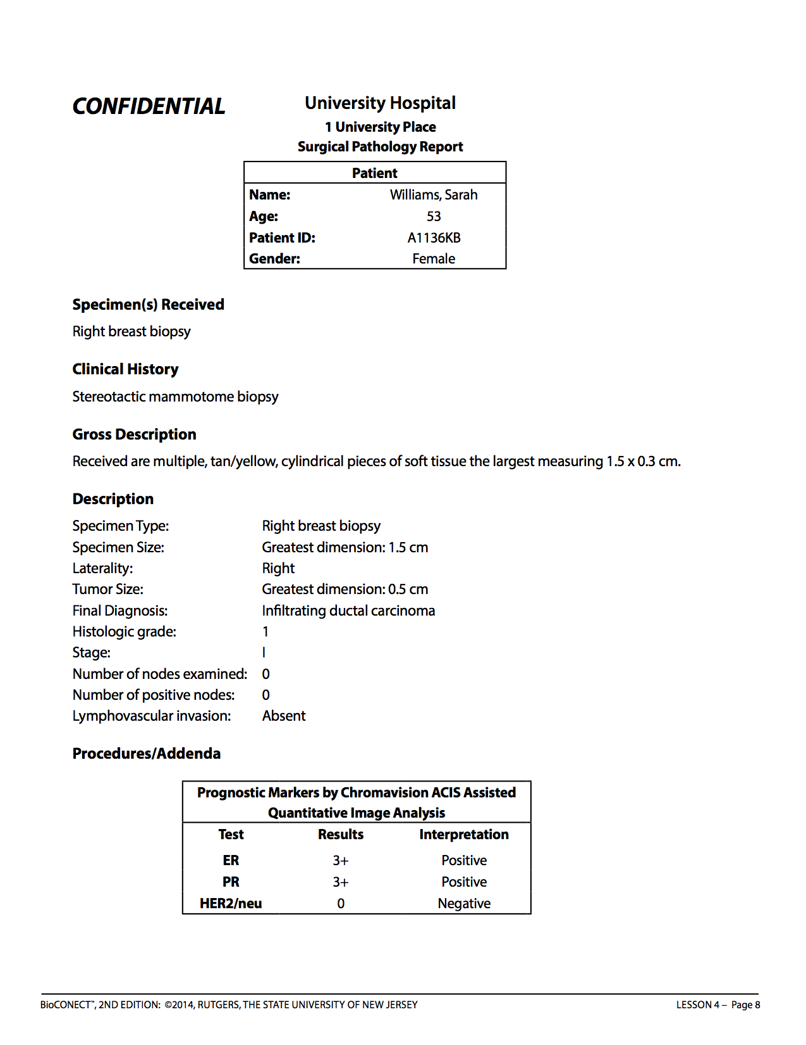
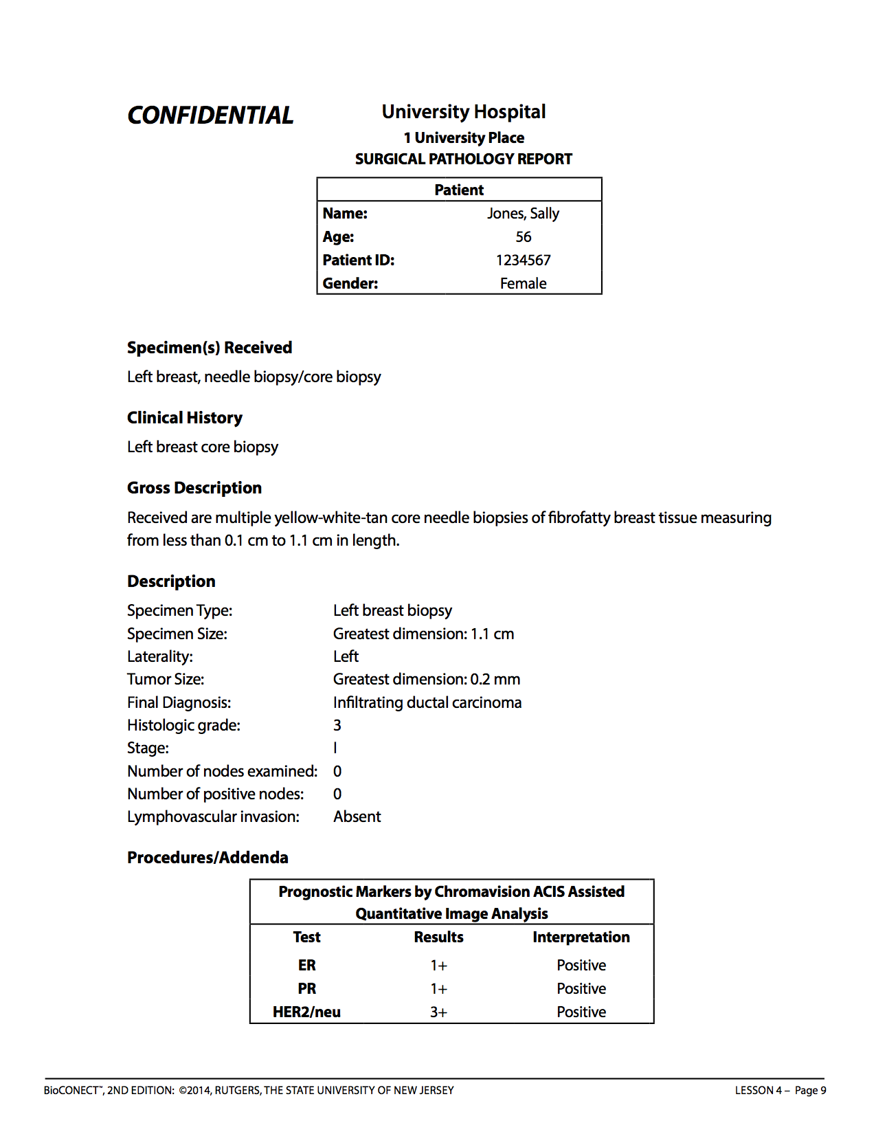
Notes:
Instructor Notes
Distribute a different pathology report to each group (actual patients)

Slide 20
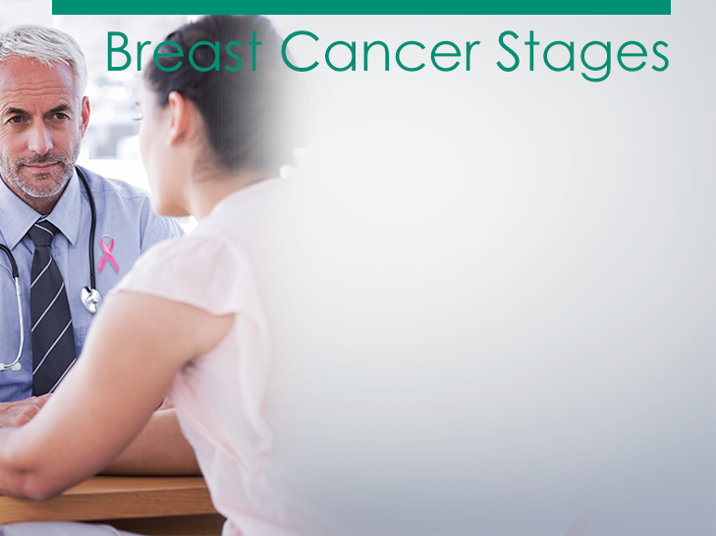
  To plan treatment, doctors need to know the extent (stage) of the disease. The stage is based on the size of the tumor and whether the cancer has spread.
  Stage 0
  Stage I
  Stage II
  Stage III
  Stage IV
Notes:
Instructor Notes
Explain to students that to plan treatment, doctors need to know the extent (stage) of the disease. The stage is based on the size of the tumor and whether the cancer has spread. Staging may involve x-rays and lab tests. These tests can show whether the cancer has spread and, if so, to what parts of the body. When breast cancer spreads, cancer cells are often found in lymph nodes under the arm (axillary lymph nodes). The stage often is not known until after surgery to remove the tumor in the breast and the lymph nodes under the arm.
Next, tell students that they will be dividing into small groups to discuss the differences between the stages. Emphasize that this is just an exercise to see what they know before learning about the stages. Ultimately you will be discussing how these stages relate to pathology reports.
Learning Activity: Breast Cancer Stages
Divide the class into 3-6 groups and have students brainstorm what they know about the stages of breast cancer, and what happens in each stage. Then, ask students to share any questions they have about stages of breast cancer and make a list for the class. Use the smart board and write the student responses to this question in the box provided. You can then save the notes the students make to each question by one of the following methods:
-Press Print Screen button on keyboard and past into a word document.
-Use the screen capture feature of notebook software that comes with the smart board to add the screen to a set of class notes to be shared with the class later.
-Use PowerPoint’s annotate pen and save the notes to the slide.

Slide 21
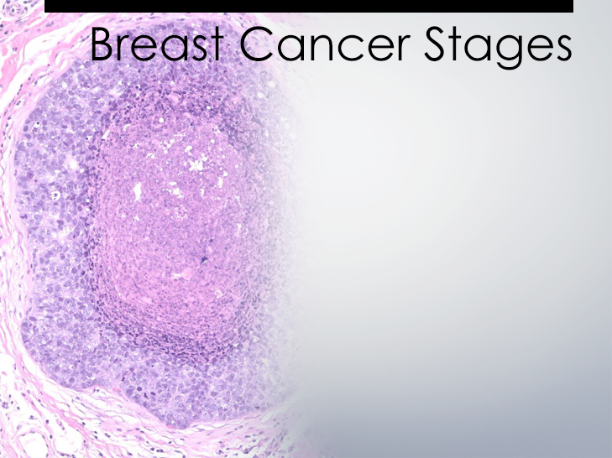
  Stage 0 is carcinoma in situ; this means that the cancer is confined to where it originally developed and has not invaded surrounding tissue.
Notes:
Instructor Notes
Keeping students in their groups, distribute the Cancer Stages handout and share information about breast cancer stages on the following 5 slides. Explain that there are two kinds of Stage 0 breast disease: Lobular Carcinoma in Situ (LCIS), which is defined by abnormal cells lining a lobe; and Ductal Carcinoma in Situ (DCIS), which is defined by abnormal cells lining the duct. LCIS is a marker for increased risk of developing breast cancer. DCIS can sometimes become invasive.

Slide 22
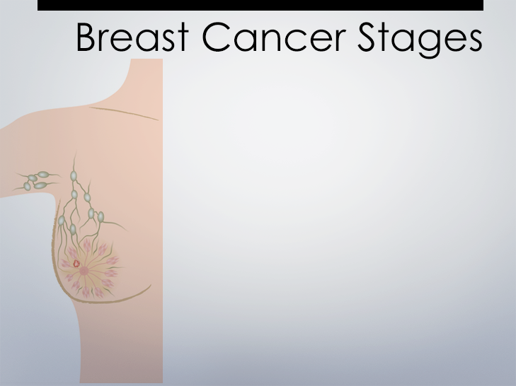
  Stage I is an early stage of invasive cancer; tumor size is 2 cm or less; no cancer cells outside of the breast.
  REAL WORLD COMPARISON:
  What small object is about 2 cm large?
  ANSWER:
  A 2 cm tumor is about the size of a shelled peanut.
Notes:
Instructor Notes
Discuss Stage 1 cancer – and refer to the handout as needed. Ask for a volunteer to explain the difference between Stage 0 and Stage I cancer.

Slide 23
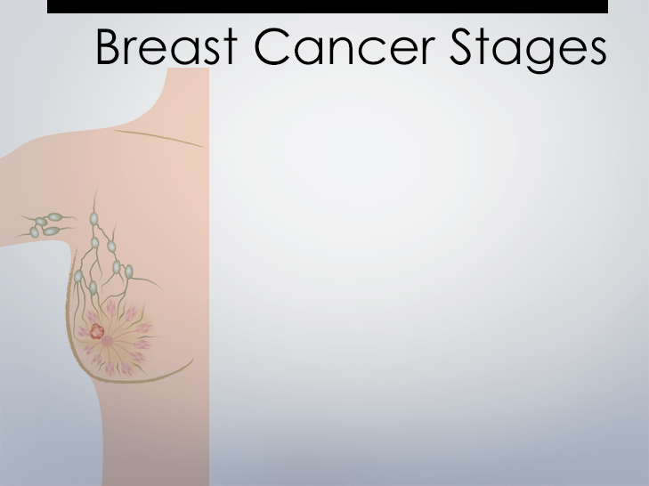
  Stage II cancer meets one of
  the following:
  Stage IIA Tumor size is 2 cm or less and cancer has spread to underarm lymph nodes or Tumor size is between 2 and 5 cm and there is no cancer outside the breast;
  Stage IIB Tumor size is between 2 and 5 cm and cancer has spread to underarm lymph nodes or tumor size is greater than 5 cm and there is no cancer outside the breast.
Notes:
Instructor Notes
Discuss Stage II cancer, and ask students to share in their own words what makes a cancer Stage II versus Stage I or Stage 0.
REAL WORLD COMPARISON: What small object is about 5 cm large? ANSWER: A small lime is approximately 5 cm large.

Slide 24
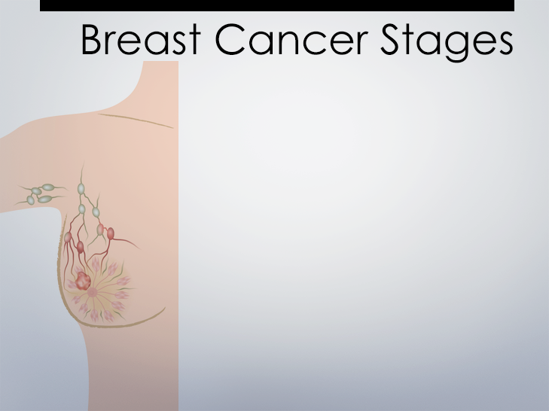
  Stage III is locally advanced cancer. This stage is divided into three categories:
  Stage IIIA
  Stage IIIB
  Stage IIIC
Notes:
Instructor Notes
Discuss the three categories of Stage III cancer on this slide and the three following. Discuss how these stages differ from previous ones, and each other.

Slide 25
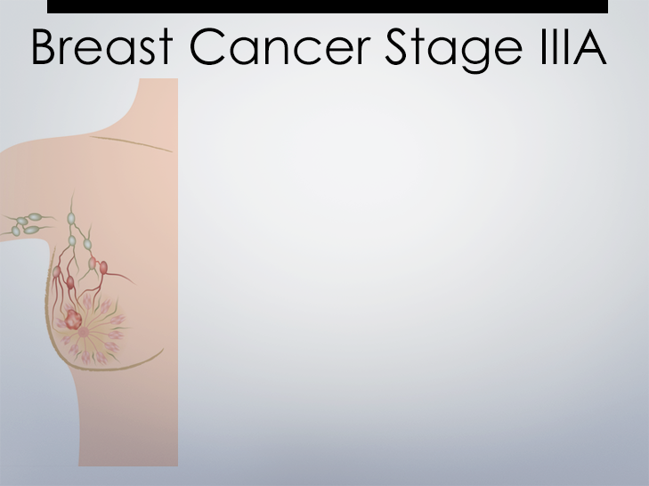
    Tumor size is 5 cm or less; The cancer has spread to more than 3 lymph nodes under the arm and may be either
    alone or attached to each other or
    to other structures. Or the cancer may
    have spread to lymph nodes behind
    the breastbone.
    Tumor size is greater than 5 cm; The cancer has spread to more than 3 underarm lymph nodes and may be either alone or attached to each other or to other structures. Or the cancer may have spread to lymph nodes behind the breastbone.
Notes:
Instructor Notes
Stage IIIA is one of the following
Tumor size is 5 cm or less; The cancer has spread to more than 3 lymph nodes under the arm and may be either alone or attached to each other or to other structures. Or the cancer may have spread to lymph nodes behind the breastbone.
Tumor size is greater than 5 cm. The cancer has spread to more than 3 underarm lymph nodes and may be either alone or attached to each other or to other structures. Or the cancer may have spread to lymph nodes behind the breastbone.

Slide 26
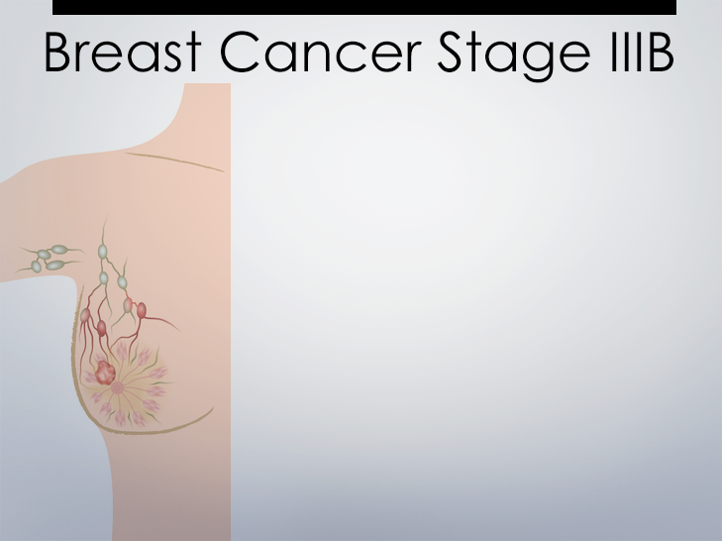
    Tumor of any size that has grown into the chest wall or the skin of the breast. It may be associated with swelling of the breast or with nodules (lumps) in the breast skin.
    The cancer may have spread to underarm lymph nodes, lymph nodes which are attached to each other or to other structures, or lymph nodes behind the breastbone.
Notes:
Instructor Notes
Stage IIIB
Tumor of any size that has grown into the chest wall or the skin of the breast. It may be associated with swelling of the breast or with nodules (lumps) in the breast skin.
The cancer may have spread to underarm lymph nodes, lymph nodes which are attached to each other or to other structures, or lymph nodes behind the breastbone
Stage IIIC
Tumor of any size which has spread either to lymph nodes behind the breastbone and under the arm or to lymph nodes above or below the collarbone.

Slide 27
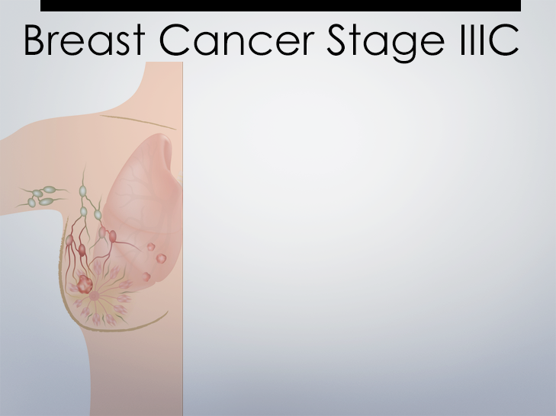
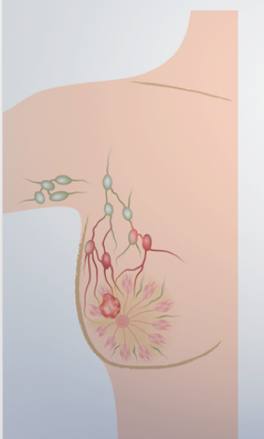
  Tumor of any size which has spread either to lymph nodes behind the breastbone and under the arm or
  to lymph nodes above or below
  the collarbone.
Notes:
Instructor Notes
Stage IIIC
Tumor of any size which has spread either to lymph nodes behind the breastbone and under the arm or to lymph nodes above or below the collarbone.

Slide 28
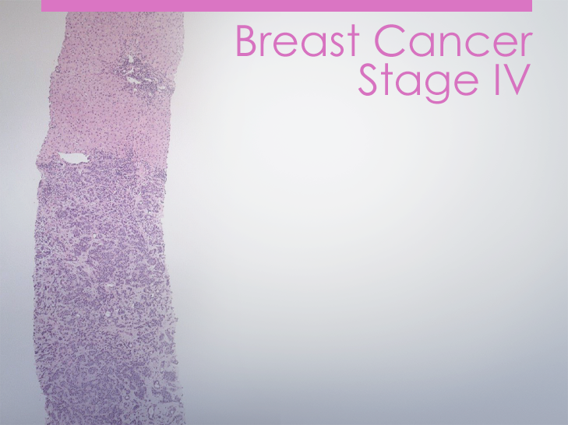
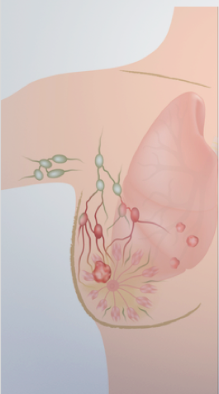
  Stage IV is distant metastatic cancer; the cancer has spread to other distant parts of the body.
Notes:
Instructor Notes
Stage IV breast cancer. Discuss how this stages differs from previous ones.

Slide 29

Patient Information: Identifies the patient and includes name, birthday, age, gender and identification number.
Clinical history of the patient: Refers to the patient’s breast cancer history, such as any procedures that have been done and/or a diagnosis
Where the specimen(s) was taken from: The location and laterality of the sample’s source.
Gross Description: Refers to the color and size of tissue sample.
Type of cancer: Refers to the final diagnosis and stage.
Lymph node status: Describes the number of lymph nodes involved and whether any have cancerous cells in them.
Hormone receptor status (ER/PR): Whether or not the sample has many estrogen and/or progesterone receptors.
HER2/neu status: Whether or not the
cells in the sample have many
HER2/neu receptors.
Notes:
Instructor Notes
Distribute Tumor Grade handout to each group to use with other handouts they have for the following learning activity.
Learning Activity: Interpreting Pathology Reports
Next, ask each group to create a chart or presentation highlighting information for their patient indicated on the slide. Make sure students are able to locate the relevant information and remind them to refer to A Guide to Interpreting a Pathology Report, Cancer Stages and Tumor Grade for assistance. When the groups have completed their chart, display them in the room and have each group present their patient’s report.
Instructor Notes
Distribute a different pathology report to each group (actual patients)

Slide 30

Review the pathology report for Sarah Williams and write an answer to Steve’s question:
What is a pathology report used for?
Why is it so important to be able to
read them?
Include detail about what each section of the pathology report means, and how it will be used by doctors.
Notes:
Instructor Notes
Ask students to demonstrate their understanding of a pathology report with this writing assignment.

Slide 31
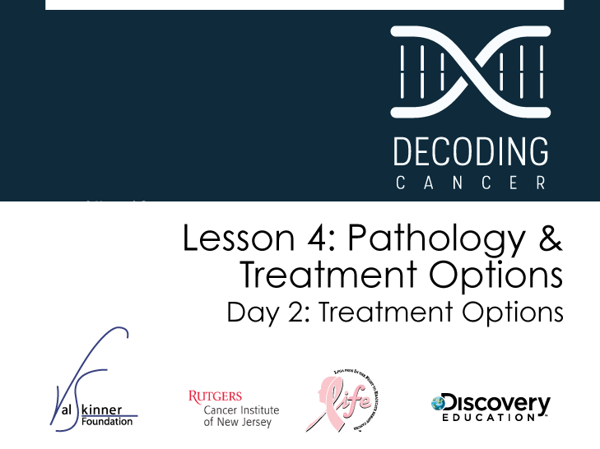
Notes:
Instructor Notes
Students investigate the different treatment options for patients with breast cancer. They will also review the pathology reports from Day 1 to draw conclusions about possible treatment approaches based on evidence.

Slide 32

Why could it be important for people with cancer (and their families) to learn about all treatment options, even if they only need one type?
Notes:
Instructor Notes
Ask one or two students to share their experiences with an injury or illness that led to choosing a method of recovery. This could include taking a certain type of medication that had side effects versus another, or doing physical therapy instead of surgery. Or, share an example from your life in which you had a choice to make and ask for students to share what their decision would have been and why.
Learning Activity
This activity should get students talking choices, pros and cons of decisions, and how an individual’s lifestyle, age, or general preference can come into play when making health decisions.

Slide 33

I never knew there were so many different cancer treatments.
Does anybody know about the different treatments?
We don’t know what mom should do and what’s going to happen to her. Is she going to lose her hair?
Notes:
Instructor Notes
Review
Begin by reviewing the learning activity from Lesson 1, What Do You Believe? Focus on the following statements and review the answers:
Treating cancer with surgery can cause it to spread throughout the body.
Cancer is something that can be effectively treated. There is currently a cure for cancer but the medical industry won’t tell the public about it because they make too much money treating cancer patients.
Next review relevant cancer treatment questions generated in Lesson 1, if applicable. If you feel comfortable, students could also share any experiences of family members or friends who have gone through cancer treatment.

Slide 34

K | W | L
What do you know? | What do you want to know? | What have you learned (or observed)?
Notes:
Instructor Notes
Learning Activity: KWL Chart
Divide the class into five-person groups and distribute flip chart paper and markers to each group. Ask the groups to create a KWL chart. Allow groups time to complete their KWL chart. Post each group’s chart and discuss as a class.
Optional: Students can also do this using an online shared Google doc and project their work on the Smartboard.

Slide 35

Biological therapy
Chemotherapy
Hormone therapy
Radiation therapy
Surgery
Notes:
Instructor Notes
Introduce the Treatment Options Jigsaw Activity. Emphasize that during this jigsaw, each individual student is responsible for his or her own work and that the success of the group depends on the work of every person. Use the same groups that were created for the previous KWL activity.
Learning Activity: Treatment Options Jigsaw
A. Use the same groups that completed a KWL chart together. Assign or ask groups to select a leader, recorder, typist, etc.
B. Assign each student in the KWL jigsaw group a cancer treatment (or combined treatments depending on the size of the group). The five cancer treatments included are 1) biological therapy, 2) chemotherapy, 3) hormone therapy, 4) radiation therapy and 5) surgery. You can chunk the treatments together if you prefer to work with fewer groups. Tell the class that each student in their group will become an expert in one treatment (or treatments, if you chunk treatments together.)
C. Have each treatment expert group gather separately. Provide each expert group with the appropriate Cancer Treatment factsheet(s) and the Cancer Treatment Summary worksheet.
D. Allow the Treatment expert groups to read their specific treatment factsheet. As an expert group, they should seek to answer the questions generated in Lesson 2 or from the KWL charts, and complete the appropriate row for their treatment on the Cancer Treatments Summary worksheet. Students do not need to memorize the information, but should have a firm understanding of the treatment information. They may need to do additional research if the factsheet does not answer all their questions.
E. After each Treatment expert group has discussed their treatment, have students regroup into their original KWL jigsaw group.
F. Each expert then presents information to their KWL jigsaw group on their assigned treatment and states what the Treatment expert group consensus was on the characteristics of the treatment. While the information is discussed, students complete their charts on the Cancer Treatment Summary worksheet.
G. Be mindful of each group’s progress by moving around the room and asking the group leaders to describe how the lesson is going. If problems arise with students who are not participating, work with that specific group to draw the information out of the student.
H. Have each jigsaw group complete their KWL chart by filling in the L column (what they learned). Review the updated KWL charts as a class.
I. Collect the KWL charts from each group at the end of the lesson. The KWL charts could be used to create an assessment for students.
Optional: You can also do this as a Safari activity. Have each group research their treatment option and create a poster. Display the completed posters and allow students time to examine all posters. Have each group present their poster to the rest of the class.

Slide 36

Treatment | Impact on cell activity | Materials & Equipment | Side effects | Used when …
Binds to sites on cells and blocks proteins allowing cancer cells to grow
Patient tests
HER2/neu
positive
Biological
Therapy
Drugs
Can affect the heart’s ability to pump blood
A tumor is large and needs to be shrunk before surgery or as part of therapy after surgery has removed part or all of the breast
Hair loss, bruising, more susceptible to infections, fatigue, nausea, diarrhea
Destroys cells
with anticancer drugs
Drugs: IVs and/ or pills
Chemotherapy
Prevents cancer cells from getting or using the hormones they need
Drugs and possible surgery to remove ovaries
Patient tests positive for estrogen and progesterone receptors
Hormone
Therapy
Symptoms of
menopause

Slide 37
Treatment | Impact on cell activity | Materials & Equipment | Side effects | Used when …
A lumpectomy is performed, or after a mastectomy when the tumor is larger
Radiation
Therapy
Destroys cells
with internal or external radiation
Source of
radiation
Redness, swelling, fatigue
Removes some or all cancer cells/ tissues
Anesthesia, Scalpel, etc
Wound infections,
pain, tenderness
Patient is recommended to remove part or all of the breast
Surgery

Slide 38

Clinical Trials: Facts and Myths
People who join clinical trials are just “guinea pigs” for research.
A person can leave a clinical trial whenever they want.
Cancer treatment clinical trials only provide “last resort” treatment.
You do not have to have cancer to participate in a cancer clinical trial.
Many people who join cancer treatment clinical trials get a sugar pill (placebo) instead of being treated.
Positive results from studies conducted on mice may not translate into positive outcomes for humans.
Clinical trials are only held in large cities.
New treatments may not always be better than standard treatments.
There are no real benefits to participating in a clinical trial.
A person can only sign up for a clinical trial if they agree to it.
Notes:
Instructor Notes
Ask students to complete the first part of this activity before moving onto the following slides, which provide answers to “facts” versus “myths”.
Learning Activity: Clinical Trials – Facts and Myths
Divide the class into groups of four to six students. Give each group one set of Clinical Trials: Facts and Myths cards. Tell the groups to divide the cards into two piles: Fact and Myth.
Optional: An online survey tool can be used in conjunction with students’ smartphones instead of small groups and cards.

Slide 39

MYTH
Explanation: People who decide to take part in a clinical trial are called participants, and strict guidelines are in place to ensure that these volunteers are treated humanely and provide opportunities to access new therapies that are not commercially available.
People who join clinical trials are just “guinea pigs” for research.
Notes:
Instructor Notes
Once the “Fact or Myth?” cards have been placed in piles, go through the statements on the following slides to learn about the correct answers.
The following is further information: A participant has the right to withdraw from a trial at any time. The participant may also discuss further treatment options with the study physician or be referred back to a primary care provider for standard care. Survey results show 97% of people were treated with dignity and respect, and that the quality of care they received was “excellent” or “good.”

Slide 40
FACT
Explanation: People who decide to take part in a clinical trial can leave the study at any time.
A person can leave a clinical trial whenever they want.
Notes:
Instructor Notes

Slide 41
MYTH
Explanation: Cancer clinical trials are not only for patients in the end stages of their disease, but for many newly diagnosed cancer patients as well.
Cancer treatment clinical trials only provide “last resort” treatment.
Notes:
Instructor Notes
The following is additional information about cancer treatment clinical trials: If only the sickest patients participated in treatment trials, researchers would not know how to treat patients with earlier stages of cancer. Phase III treatment clinical trials cover all stages of cancer, from the most advanced to the most localized.

Slide 42
FACT
Explanation: Three types of trials are available to people without cancer:
(1) Prevention,
(2) Early detection/screening, and
(3) Diagnostic.
You do not have to have cancer to participate in a cancer clinical trial.
Notes:
Instructor Notes
The following is additional information about the types of cancer trials available to people without cancer:
• Prevention trials study ways to prevent cancer,
• early detection/screening trials look at ways to improve the early detection of cancer,
• and diagnostic trials focus on ways to test for cancer or identify it better.
Each study has its own guidelines about who can participate. Generally, participants are alike in key ways, such as the type and stage of cancer they have, age, gender and other factors.

Slide 43
MYTH
Explanation: Placebos are rarely used in cancer treatment trials. No one is ever given a placebo when an effective treatment is available. However, in rare cases, a placebo may be used when testing a new drug if there is no known effective treatment.
Many people who join cancer treatment clinical trials get a sugar pill (placebo) instead of being treated.
Notes:
Instructor Notes

Slide 44
FACT
Explanation: A clinical trial is one of the steps of a long and careful cancer research process. Getting promising results from testing a new drug on mice, for example, is a preliminary step to human research studies. Treatments that work well in mice do not always work well in people.
Positive results from studies conducted on mice may not translate into positive outcomes for humans.
Notes:
Instructor Notes

Slide 45
MYTH
Explanation: Clinical trials are underway all over the country-in cancer centers, major medical centers, community hospitals and clinics, physicians’ offices and veterans’ and military hospitals in numerous cities and towns around the United States.
Clinical trials are only held in large cities.
Notes:
Instructor Notes

Slide 46
FACT
Explanation: New treatments under study are not always better than, or even as good as, standard treatments—and they may have unexpected side effects. Through a process called informed consent, participants learn about a study’s treatments and tests, and their possible benefits and risks, before deciding whether or not to participate.
New treatments may not always be better than standard treatments.
Notes:
Instructor Notes

Slide 47
MYTH
Explanation: People can benefit from clinical trials. In treatment trials, for example, participants receive high-quality cancer care and will be among the first to benefit if a new approach is proven to work.
There are no real benefits to participating in a clinical trial.
Notes:
Instructor Notes

Slide 48
FACT
Explanation: Researchers running the clinical trial are required by law to present and explain the study as part of the informed consent process. This process includes signing an informed consent document, discussing with the research team what the trial entails and understanding the potential risks and benefits
of participating.
A person can only sign up for a clinical trial if they agree to it.
Notes:
Instructor Notes
The following is further information about signing up for clinical trials: Although reputable researchers do not fool people or sign them up against their will, sometimes people have difficulty understanding the information they need to know about a trial before agreeing to join. For many people, it is important to ask a friend or family member to come with them to be sure that all important questions are raised. Taking notes or using a tape recorder can also help.
Discussion question: Ask the group what they learned about clinical trials and what they would still like to learn.

Slide 49
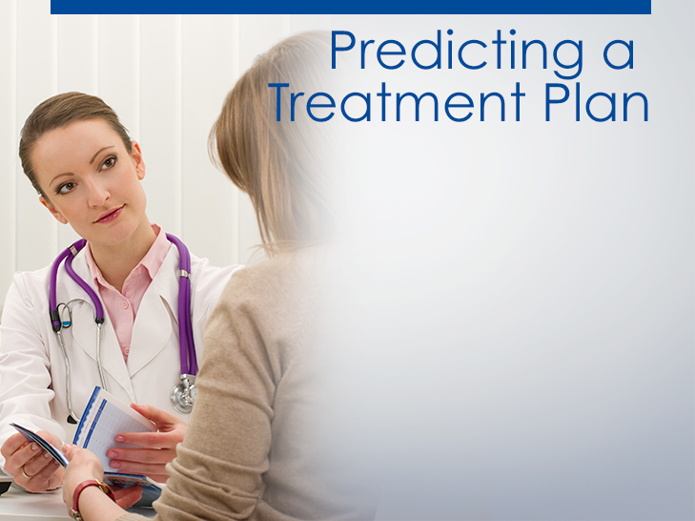
Item | Notes
Name / Age
Clinical history
Staging / Overall stage
Estrogen / Progesterone receptor test
HER2/neu test
Treatment recommendations
Notes:
Instructor Notes
Tell students they will be applying their knowledge of cancer treatments to suggest treatment options. Have students work in the same groups from yesterday when they were interpreting and reading a sample pathology report. However, you can also mix students so that groups are made up of students who reviewed different pathology reports in Day 1. You may also wish to have a jigsaw group review reports, so that each group contains an expert on each treatment type.
Learning Activity: Predicting a Treatment Plan
Distribute the sample pathology reports to each group from Lesson 4 and provide copies of the Treatment Choices by Stage factsheet. Depending on time, you may want each group to work with one pathology report or multiple reports. If you are able to have students work with multiple reports, you will be able to compare treatment options across groups.
Have students get their copy of A Guide to Interpreting a Pathology Report from yesterday. Tell each team to create a chart highlighting the following information for all of the pathology reports.
A. Patient’s name and age
B. Clinical history
C. Staging and what the overall stage of the cancer is
D. Estrogen and progesterone receptors test results
E. HER2/neu test results
F. Treatment recommendations
Walk around the room to make sure students are able to locate these items and remind them to refer to A Guide to Interpreting a Pathology Report and related factsheets for assistance.
When the groups have completed their chart, display them in the room and have students present their recommendations for treatment options. Have groups justify their treatment recommendations. If groups do not come to the same recommendation, have the groups discuss their differences and come to a consensus.

Slide 50
Review the pathology report for Sarah Williams and make a recommendation for treatment options based on her breast cancer and the handout Treatment Choices by Stage Justify your recommendation for treatment based on what you learned today.
Notes:
Instructor Notes
Distribute Treatment Choices by Stage handout to students. For homework, have each student review Sarah Williams’ pathology report and make a recommendation for treatment options based on her breast cancer. Students should
justify their treatment recommendation.

Slide 51

Notes:
Instructor Notes
Learning Activity: Designing a Clinical Trial
Review the requirements for a scientific experiment if necessary for your students.
Divide the class into groups of 3-5 students (have an even number of groups). Distribute the Clinical Trials Factsheet and have students read it. Tell groups they will be designing a clinical trial.
Distribute the Design a Clinical Trial worksheet and allow enough time for students to answer the questions. Once groups have finished, have each group present their protocol to a partner group. After all groups have shared their clinical trial, allow time for groups to revise their protocols, if necessary. Ask students if they think Sarah Williams would be a good candidate for their studies. You can also have each group present their trial to the whole class. Then create a class-wide clinical trial by taking elements from each group’s protocol.

Slide 52

Write a letter to a fictional patient who would be an ideal candidate for the study. The letter should describe the study
and summarize the risk and benefits.
Notes:
Instructor Notes
Ask the class to write a letter to a fictional patient who would be an ideal candidate for the study.
Use the smart board and write the student responses to this question in the box provided. You can then save the notes the students make to each question by saving by one of the following methods:
-Press Print Screen button on keyboard and past into a word document.
-Use the screen capture feature of notebook software that comes with the smart board to add the screen to a set of class notes to be shared with the class later.
-Use PowerPoint’s annotate pen and save the notes to the slide.

Slide 53

Notes:
Instructor Notes
Pass out the Lesson 4 Quiz to assess students’ understanding of Lesson 4 objectives.

