Slide 2
Upon completion of this lesson, you will be able to:
Identify different diagnostic procedures for breast cancer screening
Describe different diagnostic procedures for breast cancer screening
Compare different diagnostic procedures for breast cancer screening
Notes:
Instructor Notes
Lesson Summary: Students investigate early detection plans and explore the various diagnostic tools used in breast cancer detection and tracking by building an online directory using wiki technology.
Lesson Duration: One or two 45-60 minute class periods

Slide 3
Mom was telling us about all of the tests she had: mammogram, ultrasound, biopsy, and something called an MRI?
Their names are all so confusing! Why did she need so many tests? She still has a ton of appointments.
Notes:
Instructor Notes
Review
Begin by reviewing essential concepts from Lesson 1, particularly the following:
What is cancer?
What is the relationship between the cell cycle and the development of cancer?
Learning Activity
Have students pair off and brainstorm why Nikki and Steve’s mom might have to undergo so many tests at the outset of her treatment. Students should make predictions about what the doctors are trying to determine and share their ideas with the class.

Slide 4
What Are Diagnostic Tests?
Diagnostic tests like the ones that Nikki and Steve’s mom underwent provide doctors with information they need to identify illnesses, help patients understand why they’re sick, and make decisions about their care.
Some common types of diagnostic imaging include:
X-rays
Ultrasounds
MRIs (Magnetic Resonance Imaging)
Blood tests
Biopsy
Notes:
Instructor Notes
Introduce the concept of diagnostic imaging to the class covering the following points:
Discussing the general purpose of diagnostic imaging and common uses when these technologies are used (both specific to and apart from cancer contexts).
Diagnostic testing are procedures that help doctors diagnose an illness or condition or to evaluate its severity.
Some diagnostic tests are image based: healthcare professionals use technology to develop pictures of organs or specific areas within the human body. Radiologists interpret these images for clues about an illness.
Some diagnostic tests involve analyzing samples of fluid or tissue from patients in laboratories.

Slide 5
Have you, or anyone close to you, had an x-ray, ultrasound, MRI, or blood test?
Notes:
Instructor Notes
Ask one or two students to share their experiences with personal diagnostic imaging.
Learning Activity
This activity should get students talking about their or their family members’ broken bones, visits to the dentist, pregnancies, and other common experiences that would necessitate the use of diagnostic imaging. Connect these tools of diagnosis to similar tools used to diagnose and treat cancer.

Slide 6
Steve and Nikki’s mom needs several tests because each test can reveal different information about her diagnosis. The more that Nikki’s mom and her doctors know about her illness, the better they will be able to treat it.
Notes:
Instructor Notes
Emphasize that diagnostic tests are used during the information gathering stage of a doctor’s treatment. It is important to have information collected from diagnostic testing so everyone involved is able to make the most informed and effective decisions about care. Furthermore, while diagnostic imaging tools may help detect and diagnose cancer, the only way to diagnose cancer definitively is to evaluate tissue under a microscope.
Note that the tests themselves do not treat the disease, but provide critical information about it. Explain that people also often undergo medical testing in health screenings — regular testing of individuals in specific demographics or who meet certain criteria, such as age or family history.

Slide 7
There are specific diagnostic tests that help doctors diagnose and plan treatment for breast cancer
Mammograms
Ultrasounds
MRIs
Biopsies
Notes:
Instructor Notes
Introduce the four main tests students will investigate and ensure they know how to pronounce them. Explain that mammograms, ultrasounds, and MRIs are all different types of imaging procedures and that they each have different strengths and purposes that students will research on their own. Check prior knowledge by asking if anyone knows what a biopsy is. If necessary, explain that biopsies are tissue samples that are taken from patients and analyzed by specialists for clues about a disease.
Learning Activity
Distribute the Blank Diagnostic Tools handout. Instruct students to take notes using the graphic organizer while you present the information on the subsequent slides. Note that the content on the subsequent slides is intentionally left at a very general level. More detail is provided in the instructor notes section. You can include additional detail as desired during this portion of the lesson; students will be researching and investigating this content on their own later in the lesson. This particular activity is meant to provide some background knowledge for students to use before they start their research. If you do not cover all the detail while introducing the four diagnostic tools over the next slides, encourage students to fill in gaps in their Diagnostic Tools graphic organizer throughout the remainder of the lesson.

Slide 8
A mammogram is an x-ray of breast tissue.
Mammograms can reveal abnormalities in breast tissue that may indicate the likelihood of the presence of cancer.
The size, shape, and edges of findings in a mammogram can give doctors information about the likelihood that cancer is present.
Notes:
Instructor Notes
Emphasize that the mammogram is the only diagnostic test that is also used in routine health screenings. Note that different medical groups have different guidelines for when women should start receiving mammograms. Research is ongoing about the most effective schedule for catching and treating cancer. In general, women over 40 are advised to receive a mammogram every 1 to 2 years depending on their family history and other individual circumstances. Also, it is important to know that women in their 20s and 30s can get breast cancer and men can get breast cancer, as well. However, it is much less common than in women over 40.
Breast cancer tissue often appears as having a jagged outline and an irregular shape. Radiologists look for places where calcifications, which appear as small white spots on a mammogram, are grouped together in a certain way. On a mammogram, a benign growth often looks smooth and round with a clear, defined edge. Breast cancer often has a jagged outline and an irregular shape.
Radiologist: Radiologists are medical doctors or doctors of osteopathic medicine (DOs) who specialize in diagnosing and treating diseases and injuries using medical imaging techniques, such as x-rays, computed tomography (CT), magnetic resonance imaging (MRI), nuclear medicine, positron emission tomography (PET) and ultrasound.”
Source: American College of Radiology: What is a Radiologist? Retrieved from http://www.acr.org/Quality-Safety/Radiology-Safety/Patient-Resources/About-Radiology
Image
Close-up of the x-ray panels of a mammography machine. [[from DE Virtual Lesson 2/Extra Images from CINJ for Lesson folder]]
A mammogram of a woman’s breast including a suspicious abnormality. [[from DE Virtual Lesson 2/Extra Images from CINJ for Lesson folder]]

Slide 9
MRI
Magnetic Resonance Imaging (MRI) uses a magnet, radio waves, and a computer to create hundreds of images of a part of the human body.
Radiologists interpret the results to look for clues that help with diagnosing cancer.
Notes:
Instructor Notes
Unlike mammograms, MRI is not part of the regular screening process for breast cancer, but this tool is used in various specific circumstances.
To create an MRI of the breast, a patient lies face down on a table and a the breast hangs through a hole. Then the patient is moved into a tube-like machine. An MRI session takes about one hour to collect the necessary images.
Note that MRI is still being researched in terms of how it can most effectively be used to understand and treat breast cancer in patients.
MRI can be used to investigate abnormal areas seen on a mammogram. MRI shows differences or abnormalities in tissue that allow radiologists to say how likely the abnormality represents a cancer. MRI can also be used after diagnosis to evaluate the extent to which a cancerous growth has spread. MRI is effective at evaluating dense breast tissue.

Slide 10
Biopsies
Biopsy
A biopsy is a diagnostic procedure that involves removing a tissue sample from a patient.
Pathologists analyze the fluid or tissue to detect cancerous cells.
Biopsies are the only definitive way to diagnose the presence of cancer.
Notes:
Instructor Notes
Doctors and nurses collect samples for analysis. These samples are sent to pathology labs where specialists investigate the samples for information about the patient’s health. Doctors use the pathologist’s analysis to determine the best course of care and to keep patients informed about their illness.
Optional Learning Activity
Have students work in pairs or small groups to research what pathologists do using the questions below as a guide. Have students share their findings.
Optional resource: What is Pathology? Retrieved from http://www.news-medical.net/health/What-is-Pathology.aspx
Are pathologists doctors?
Where do they work?
Do pathologists work exclusively with cancer patients?
What do pathologists do?
How do pathologists help patient-care teams?

Slide 11
Biopsies
One term you are likely to come across as you learn about biopsies is pathology.
Pathology is a branch of medicine. Pathologists, or doctors who study pathology, examine patients and samples taken from their bodies for clues that might indicate certain diseases.
Notes:
Instructor Notes
Doctors and nurses collect samples for analysis. These samples are sent to pathology labs where specialists investigate the samples for information about the patient’s health. Doctors use the pathologist’s analysis to determine the best course of care and to keep patients informed about their illness.
Optional Learning Activity
Have students work in pairs or small groups to research what pathologists do using the questions below as a guide. Have students share their findings.
Optional resource: What is Pathology? Retrieved from http://www.news-medical.net/health/What-is-Pathology.aspx
Are pathologists doctors?
Where do they work?
Do pathologists work exclusively with cancer patients?
What do pathologists do?
How do pathologists help patient-care teams?

Slide 12
Ultrasound machines use sound waves to create images of areas within the body.
Ultrasound imaging of the breast is used to distinguish between solid lesions and fluid-filled cysts, among other uses.
Notes:
Instructor Notes
Note that ultrasounds are sometimes used to help guide biopsy needles to targeted areas within the breast tissue. You may also want to make the connection that this technology is the same method that is used to get early images of a developing fetus within a pregnant woman. The wand that emits the ultrasonic waves is called a transducer.
To conduct an ultrasound, a medical professional will cover the skin with a lubricating gel and then use a wand to direct the sound waves.
Ultrasounds are not part of regular screenings. They are an additional diagnostic tool

Slide 13
Consider the following review questions about the four main types of diagnostic tests for breast cancer.
Notes:
Instructor Notes
Lesson Activity
Allow students some time to review the notes they took in their graphic organizers. Then, lead them through these review exercises as a form of guided practice for the independent practice they will perform for the class’s writing assignments. For each of the following slides, present the slide to the class, invite volunteers to share an answer, and then reveal the correct answer.

Slide 14
This is an image created by taking an x-ray of breast tissue.
Notes:
Correct Answer:
Mammogram

Slide 15
For this diagnostic test, patients lie on a table inside a large tube-like machine that creates hundreds of images of the breast.
Notes:
Correct Answer:
MRI

Slide 16
This tool is used in routine screenings for breast cancer.
Notes:
Correct Answer:
Mammogram

Slide 17
This procedure is the most conclusive for doctors to diagnose breast cancer.
Notes:
Correct Answer:
Biopsy

Slide 18
This procedure helps physicians determine whether a growth in a woman’s breast is a solid lesion or a fluid-filled cyst.
Notes:
Correct Answer:
Ultrasound

Slide 19
False
The purpose of a biopsy is to remove a tumorous growth.
Notes:
Correct Answer:
False. An excisional surgical biopsy may have the objective of removing an entire lump or area, but other types of biopsies, including incisional biopsies or fine needle aspirations extract only a small amount of a particular area.

Slide 20
False
Pathologists interpret MRI results.
Notes:
Correct Answer:
False. Pathologists analyze biopsies. Radiologists interpret X-rays and MRI results.

Slide 21
True
Some biopsy procedures also require the use of ultrasound equipment.
Notes:
Correct Answer:
True. Ultrasound technology can be helped to guide a needle to a lump in a breast that is difficult to palpate, or feel, or when lumps are difficult to identify on a mammogram.

Slide 22
With your group, research your assigned diagnostic tool so that you can help Steve and Nikki better understand how their mom’s breast cancer was diagnosed.
Use the information gathered in your research to design and create a wiki — a website that can be edited by multiple people — to explain the purpose and background information of your diagnostic test.
Notes:
Instructor Notes
Divide the class into small groups (one for each diagnostic procedure: mammogram, ultrasound, MRI, and biopsy). If necessary, assign diagnostic tools to more than one group.
Group Project Option
This activity could be modified by asking students to create a multimedia presentation instead of a wiki. Students can use online slide makers or video tools and create a voiceover narration to accompany the visuals they find. To incorporate the writing aspect, students could write about their findings. For example, they could write an article for Breast Cancer Awareness month or create an informative poster.

Slide 23
Make sure everyone on your team has a clear job, including the following responsibilities;
Leader
Recorder
Typist
Other jobs, as needed
Notes:
Instructor Notes
Assign, or ask groups to select, a leader, recorder, typist, etc.

Slide 24
Your group’s wiki must do the following:
Answer Nikki’s question about why her mom needs to undergo the procedure you researched
Answer all of your group’s initial questions
Include a clear organization for the content about your diagnostic procedure
Include relevant images
Include a list of three to four open-ended questions at the end
Notes:
Instructor Notes
Go over the project requirements with students, answering questions and clarifying expectations as needed. Explain that they will create a list of 3-4 open-ended questions for their classmates as a kind of “knowledge check.” These questions will be placed at the end of the wiki page. If students have trouble generating questions on their own, encourage them to consult frequently asked questions pages for some of the resources on the Wiki Resources List. Some examples are included below.
Examples of open-ended questions:
Why is this test important?
How much discomfort to patients experience while undergoing this test?
Are their downsides or negative side effects to this test?

Slide 25
Compose a list of six to eight questions about the diagnostic procedure you will research. What would you like to learn?
Review the Wiki Resource List handout.
Review the Diagnostic Tool Cards and conduct any necessary additional research.
Draft content for your wiki.
Develop wiki and share with the class.
Notes:
Instructor Notes
Go over the project overview with students and explain that you will be providing additional detail for each step of the process.

Slide 26
With your group:
Brainstorm a list of six to eight questions about your diagnostic test.
Consider the following:
What would you need to know to respond to Nikki’s post?
What do you want to know about these tests?
What kind of information might be helpful to someone about to undergo this type of diagnostic test?
Notes:
Instructor Notes
Ask each group to list questions about their assigned procedure. Have each group share their list with the class once they are finalized. Encourage students to expand their lists to incorporate questions shared by the other groups.

Slide 27
With your group:
Review the resources on the Wiki Resource List and identify the resources that look the most informative and helpful.
American Cancer Society
Centers for Disease Control and Prevention
Health Line
National Cancer Institute
National Human Genome Research Institute
Mayo Clinic
MD Anderson Cancer Center
Rutgers Cancer Institute of New Jersey
Notes:
Instructor Notes
Distribute one copy per group of the Wiki Resource List, which provides several websites that students may use to gather information for their wikis.
Tell students they are to prepare the content for their wiki using information from the online sources in the Wiki Resource List.
Tell students they will have to cite their sources and to be sure to record where they obtain each piece of information.
Note: The resources listed on this slide are a sample of the complete list of resources on the Wiki Resource List handout. The handout includes URLs for students to access these resources.

Slide 28
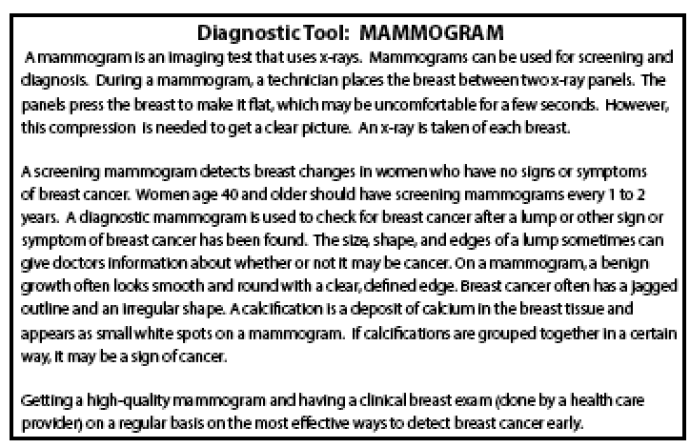
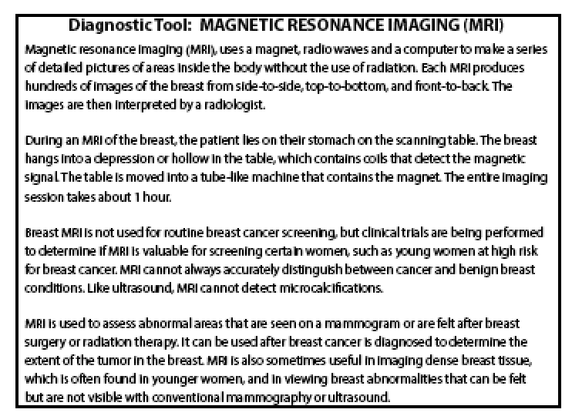
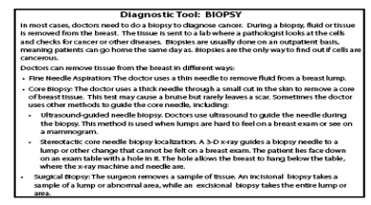
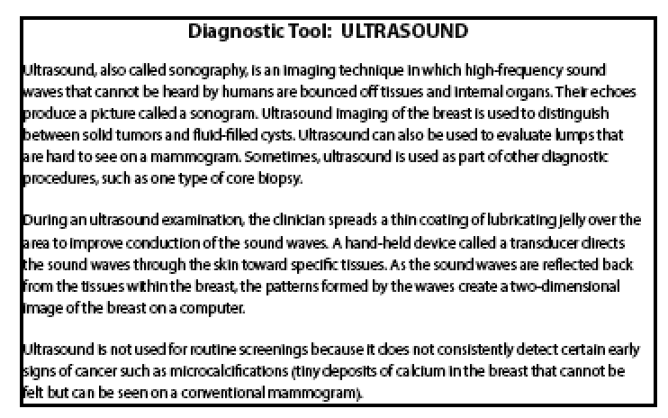
With your group:
Start conducting research to answer the questions your group posed.
Notes:
Instructor Notes
Distribute the Diagnostic Tool Cards as a reference for each group. The Biopsy group should get the Biopsy card and so on. Allow students time to read and discuss the content of the card. Students should compare the content of the card to the list of questions they brainstormed to see if the card contains some answers to they need for their wiki. They should also note what information they still need to research.
Allow time for students to research their procedure more fully and to find any relevant information for their wiki. Remind students to note their sources. They will have to cite their sources in their wiki.

Slide 29
With your group:
Organize and arrange your information into a clear and thoughtful structure that provides answers to your questions and additional information to other students.
Once your content is approved, you will use your draft to create your wiki!
Notes:
Instructor Notes
Students should prepare a “hard copy” version of their wikis before they are allowed to create the online version. If possible, students should use word processors. Otherwise, they can compile the wiki using pencil and paper or sticky notes/index cards and poster board.
Once again, remind students that they must cite their research in their wikis. The finished wiki should feature a works cited section where students should list consulted resources using the proper format.
Directions for Creating an Online Wiki
Review all group work before students create their online wiki. After the content is approved, students will create their wiki page using the online wiki tool you selected. (Use the Wiki Instruction Manual for Teachers document to become familiar with the process.). Students can search for images at the National Cancer Institute’s Visuals Online, a searchable database. Visuals Online is located at http://visualsonline.cancer.gov/.

Slide 30
With your group:
Use your draft to create your online wiki!
Be sure to include three or four open-ended questions at the end and a resource page.
Notes:
Instructor Notes
If necessary, review the Project Requirements with students. Circulate to offer students assistance and guidance as needed.

Slide 31
Using what you learned today, write a response to Nikki’s question: Why does my mom need so many tests?
Notes:
Instructor Notes
Direct students to provide a brief explanation for why all of the tests that Nikki mentions are important and what they might reveal. Stress that answers should include factual evidence from all of the groups’ wikis. As an option, this activity may be completed in class rather than as a homework assignment.

Slide 32
Answer the questions at the end of the wikis related to the three diagnostic tools you did not research.
Notes:
Instructor Notes
To assess student learning, assign students to review the wiki pages created by their classmates and answer the open-ended questions created for each wiki. Students may use the Blank or Incomplete Diagnostic Tools Summary worksheet as well as the Diagnostic Tools worksheet. Students should submit their responses to the wiki designers for review.
If it was necessary to assign a diagnostic tool to more than one group, ensure that 1) every student answers questions about the three diagnostic tools they did not research, but answers only one wiki’s questions for each tool, and 2) every group’s wiki has a set of students responding to their questions.

Slide 33
Notes:
Instructor Notes
Pass out the Lesson 2 Quiz to assess students’ understanding of Lesson 1 objectives.

