Slide 1
Notes:
Instructor Notes
In this lesson, students read profiles of the Biggest Risk Reducer Players and learn about cancer risk reduction. Students then compete in a Physical Challenge to win clues that will help them develop effective risk reduction strategies. Students develop and present risk reduction strategies for their Players.

Slide 2
Upon completion of this lesson, you will be able to:
Identify common risk factors for cancer
Discuss the risk factors for breast cancer
Evaluate the short- and long-term consequences of health practices
Predict diseases and health conditions that may occur during one’s lifespan
Develop a strategy for reducing cancer risk
Notes:
Instructor Notes
Lesson Summary: [TK] Lesson Duration: One 45-60 minute class periods.

Slide 3
“Thanks to everyone for all your help.
Mom now has hormone therapy and
is doing really well. We’ve all calmed
down a little now that we know more
about cancer and now that mom
is okay.”
Notes:
Instructor Notes

Slide 4
Things have definitely calmed down. But now that we know Steve and I may be at risk for breast cancer, what can we do to lower our risk?
Notes:
Instructor Notes
Tell the class they will develop a response to Nikki’s question, “What can we do to reduce risk?” Information about cancer prevention is available from the National Cancer Institute (NCI) at http://www.cancer.gov/cancertopics/prevention-genetics-causes. Tell students to select the Patient versions.
Learning Activity: Small Group Brainstorm
Divide the class into small groups and have students brainstorm what people can do to reduce their risk for cancer. Then, ask students to share any questions they have about pathology reports and make a list for the class. Use the smart board and write student responses to this question in the box provided. You can then save the notes the students make to each question by saving by one of the following methods:
-Press Print Screen button on keyboard and paste into a word document.
-Use the screen capture feature of notebook software that comes with the smart board to add the screen to a set of class notes to be shared with the class later.
-Use PowerPoint’s annotate pen and save the notes to the slide.

Slide 5
Will a person with one or more known risk factors always develop cancer?
Notes:
Instructor Notes
Ask students to consider the question on the slide.
Learning Activity: Class Discussion
Ask students to discuss the question: Will a person with one or more known risk factors always develop cancer? What are some examples from students’ personal lives that support their answers? Answer: No! Most people have risk factors and never develop cancer.

Slide 6
Age
Tobacco use
Exposure to ultraviolet radiation
Exposure to ionizing radiation
Some viruses and bacteria
Hormones
Family history of cancer
Alcohol use
Poor diet, lack of physical activity, or being overweight
Notes:
Instructor Notes
Explain to students that often doctors cannot explain why one person develops cancer and another does not. However, research has shown that people with certain risk factors are more likely to develop cancer. Risk factors are characteristics or behaviors that increase the possibility of developing a disease.
Learning Activity: Think-Pair-Share
Ask students to think about cancer risk factors, allowing 1-2 minutes for them to think quietly to themselves. After a few minutes, ask students to pair up with 1 or 2 other students to discuss their thoughts and make a list. After 4 or 5 minutes, go around the room and ask each group to share their list of cancer risk factors, creating one large list on the Smartboard. Once the list is made reveal the list on this slide.

Slide 7
Age
The most significant risk factor for cancer is age
Risk of cancer steadily increases with age
Notes:
Instructor Notes
Distribute the Cancer Risk Factors and Breast Cancer Risk Factors Handouts for students to refer to during Slides 6-16. Explain to students that specific risk factors are linked to breast cancer, and they can learn about those in the handout.

Slide 8
Tobacco use
Tobacco use is the most preventable cause of death
Each year more than 180,000 Americans die from cancer that is related to tobacco use
Using tobacco products or regularly being around tobacco smoke increases the risk of cancer
Smokers are more likely than nonsmokers to develop cancer of the lung, larynx, mouth, esophagus, bladder, kidney, throat, stomach, pancreas, cervix, or cancer that starts in blood cells
Notes:
Instructor Notes

Slide 9
Exposure to UV radiation
Ultraviolet (UV) radiation comes from the sun, sunlamps, and tanning booths
UV rays cause early aging of the skin and damage that can lead to skin cancer
Notes:
Instructor Notes
Explain to students that there are other approaches to prevention. The Community Preventive Services Task Force recommends education and policy interventions for the prevention of skin cancer. These interventions combine community-based communications and policy and regulation to increase preventive behaviors (such as covering up, using shade, or avoiding the sun during peak UV hours) among populations in specific settings, including primary school and outdoor recreational settings. The U.S. FDA has information to help guide patients and clinicians on the use and effectiveness of broad-spectrum sunscreens (www.fda.gov/sunscreen). It has determined that, if used as directed, broad-spectrum sunscreens with a sun-protection factor of 30 SPF or greater protect against both UV A and UV B radiation and reduce the risk for skin cancer and early skin aging. The agency also has consumer education materials on the dangers of indoor tanning.

Slide 10
Exposure to UV radiation
People of all ages should avoid exposure:
Stay out of the midday sun
Use sunscreen
Wear long sleeves and sunglasses with UV protection
Do not use sunlamps or tanning booths – they are no safer than sunlight
Notes:
Instructor Notes
Explain to students that there are other approaches to prevention. The Community Preventive Services Task Force recommends education and policy interventions for the prevention of skin cancer. These interventions combine community-based communications and policy and regulation to increase preventive behaviors (such as covering up, using shade, or avoiding the sun during peak UV hours) among populations in specific settings, including primary school and outdoor recreational settings. The U.S. FDA has information to help guide patients and clinicians on the use and effectiveness of broad-spectrum sunscreens (www.fda.gov/sunscreen). It has determined that, if used as directed, broad-spectrum sunscreens with a sun-protection factor of 15 or greater protect against both UV A and UV B radiation and reduce the risk for skin cancer and early skin aging. The agency also has consumer education materials on the dangers of indoor tanning.

Slide 11
Exposure to ionizing radiation
Sources include:
Medical procedures such as x-rays and radiation therapy
Radioactive fallout
Radon gas
Notes:
Instructor Notes
Additional information on this slide:
The risk of cancer from low-dose x-rays is extremely small. Body parts not being x-rayed are shielded to limit exposure. There is a slightly higher risk for radiation therapy. This therapy is only used if the benefits outweigh the risk.
Radioactive fallout comes from accidents at nuclear power plants, or from production, testing, or use of atomic weapons. People exposed to fallout have increased risk of cancers, especially leukemia and cancer of the thyroid, breast, lung, and stomach
Radon gas forms in soil and rocks. It cannot been seen, smelled, or tasted. It’s found in homes in certain parts of the US and in mines. People exposed to radon gas are at increased risk of lung cancer.

Slide 12
Bacteria
Being infected with certain viruses of bacteria may increase the risk of developing cancer:
Helicobacter pylori
A bacterium which can cause stomach ulcers, stomach cancer, or lymphoma in the stomach lining
Notes:
Instructor Notes
Information continues on the next slide.

Slide 13
Viruses
Being infected with certain viruses of bacteria may increase the risk of developing cancer:
Hepatitis B and C
Liver cancer can develop after many years of infection with hepatitis B or C
Human papillomavirus (HPV)
Main cause of cervical cancer has been linked to risk factor for other types of cancer
Notes:
Instructor Notes
Explain to students that there are effective ways to manage the risk due to viruses and bacteria.
(Teachers should use discretion when teaching this topic)
Do not have unprotected sex or share needles. This puts you at risk for contracting HPV, hepatitis B and C, and HIV
Talk to your doctor about getting vaccinated for hepatitis B and HPV.
If you think you are at risk for HIV or hepatitis, ask about being tested. These infections may not cause symptoms but can be diagnosed by a blood test.
If you have stomach problems talk to your doctor. Infection with H. pylori can be detected and treated.

Slide 14
Viruses
Being infected with certain viruses of bacteria may increase the risk of developing cancer:
Human T-cell leukemia/lymphoma virus (HTLV-1)
Increases risk of lymphoma and leukemia
Human herpes virus 8 (HHV8)
Risk factor for Kaposi’s sarcoma, a rare cancer
Epstein-Barr virus (EBV)
Linked to increased risk of lymphoma
Notes:
Instructor Notes
Explain to students that there are effective ways to manage the risk due to viruses and bacteria.
(Teachers should use discretion when teaching this topic)
Do not have unprotected sex or share needles. This puts you at risk for contracting HPV, hepatitis B and C, and HIV
Talk to your doctor about getting vaccinated for hepatitis B and HPV.
If you think you are at risk for HIV or hepatitis, ask about being tested. These infections may not cause symptoms but can be diagnosed by a blood test.
If you have stomach problems talk to your doctor. Infection with H. pylori can be detected and treated.

Slide 15
Viruses
Being infected with certain viruses of bacteria may increase the risk of developing cancer:
Human immunodeficiency virus (HIV)
HIV doesn’t cause cancer but enables cancer formation.
Individuals with HIV infection are at greater risk of cancers such as lymphoma or Kaposi’s sarcoma
Notes:
Instructor Notes
Explain to students that there are effective ways to manage the risk due to viruses and bacteria.
(Teachers should use discretion when teaching this topic)
Do not have unprotected sex or share needles. This puts you at risk for contracting HPV, hepatitis B and C, and HIV
Talk to your doctor about getting vaccinated for hepatitis B and HPV.
If you think you are at risk for HIV or hepatitis, ask about being tested. These infections may not cause symptoms but can be diagnosed by a blood test.
If you have stomach problems talk to your doctor. Infection with H. pylori can be detected and treated.

Slide 16
Hormones
Doctors may prescribe hormones (estrogen, or estrogen plus progestin) to women undergoing menopause
Hormones can relieve problems such as hot flashes, vaginal dryness, and thinning bones
However, menopausal hormone therapy can cause serious side effects
May increase the risk of breast cancer
Notes:
Instructor Notes

Slide 17
Alcohol Use
Having more than 2 drinks per day for many years may increase the chance of developing cancers of the mouth, throat, esophagus, larynx, liver, and breast
Risk increases with the amount of alcohol a person drinks
Risk increases for drinkers who also use tobacco
Doctors counsel drinkers to consume alcohol in moderation
No more than one drink per day for women
No more than two drinks per day for men
Notes:
Instructor Notes

Slide 18
Diet
A healthy diet includes foods high in fiber, vitamins and minerals
Whole-grain breads and cereals, 5 to 9 servings of fruits and vegetables
Limit fatty foods such as butter, whole milk, fried food, red meat
Notes:
Instructor Notes
Poor diet, lack of physical activity, or being overweight puts a person at increased risk for several types of cancer. Individuals with high fat diets have an increased risk of cancers of the colon, uterus, and prostate.
Optional Learning Activity: Think-Pair-Share
Divide students into groups of 2 or 3 and tell them they will work together to create a “healthy plate” by researching http://www.choosemyplate.gov/MyPlate. Students will need Internet access, and they should focus on a meal (breakfast, lunch, or dinner). Ask student volunteers to present their meals to the class.

Slide 19
Exercise
Be active and maintain a healthy body weight
Children and adolescents should do 60 minutes (1 hour) or more of physical activity each day
Adults should have moderate physical activity (such as brisk walking) for at least 30 minutes on 5 or more days per week
Notes:
Instructor Notes
Lack of physical activity and being overweight are risk factors for cancers of the breast, colon, esophagus, kidney, and uterus.
Optional Learning Activity: Think-Pair-Share
Ask for student volunteers to track their steps with a FitBit or other technology that registers steps for a period of time. Ask these students to track their steps at certain intervals in the day to determine most active times versus lower activity times. Ask students to share their data, and use the information to start a discussion with the rest of the class.

Slide 20
It’s not contagious
Cancer is not caused by an injury
Although being infected with certain viruses or bacteria may increase the risk of some types of cancer, no one can “catch” cancer from another person
Notes:
Instructor Notes
Explain to students that cancer is not caused by an injury nor is it contagious. You cannot “catch” cancer from another person, even though certain viruses or bacteria may increase the risk of some types of cancer.

Slide 21
Do all risk factors play a role in breast cancer risk?
Notes:
Instructor Notes
Ask students to consider the question on the slide.
Learning Activity: Class Discussion
Ask students to discuss the question: Do all risk factors play a role in breast cancer risk? Answer: No. Some risk cancers for cancer do not play a role in breast cancer risks.

Slide 22
Reflect on your own behaviors and develop a personal risk reduction plan to avoid or reduce cancer risk factors for yourself.
Write a letter to yourself in the future as an adult. Describe what you are doing now to reduce your risk of cancer, and include what some consequences of behavior could be, as well as predictable diseases or conditions based on certain behaviors.
Notes:
Instructor Notes

Slide 23
Notes:
Instructor Notes
Tell students they will be playing The Biggest Risk Reducer, a learning activity that will help them understand more about cancer risk factors. Slides 29-44 pertain to this game. Ask students if they are familiar with “The Biggest Loser,” a reality show in which participants compete to lose weight. Tell students they will be playing a variation called “The Biggest Risk Reducer,” focused on cancer risk reduction.

Slide 24
Notes:
Instructor Notes
Ask students if they or someone they know has ever tried to change a behavior to be healthier (e.g., quitting smoking, starting an exercise program, eating healthy).
Learning Activity: Group Discussion
Discuss the experiences of changing a behavior to be healthier with these questions:
Was the process of changing the behavior easy?
What obstacles were encountered?
Was the process successful?
Was there anything that helped the person to change the behavior (rewards, family support, etc.)?

Slide 25
Notes:
Instructor Notes
Divide the class into small groups of 4 to 6 students. Assign each group a Biggest Risk Reducer Player, or have them randomly pick a Player card. Allow time for groups to review their Player’s information.

Slide 26
Being over age 50
Having a BRCA1 or BRCA2 mutation
Taking hormones, such as estrogen or progesterone
Being overweight or obese
Drinking alcoholic beverages
Not getting adequate exercise
And more
Prostate Cancer
Being older (over age 50)
Have a family history of prostate cancer
Eating lots of high-fat foods
Being exposed to testosterone over a long time
And more
Lung Cancer
Smoking
Having a lung disease such as tuberculosis
Having a personal history of lung cancer
Being exposed to environmental tobacco smoke
And more
Skin Cancer
Being exposed to ultraviolet radiation (UV) rays
Having a family history of skin cancer
Having a personal history of skin cancer
Being exposed to arsenic
And more
Notes:
Instructor Notes
Ask students to refer to their copies of Breast Cancer Risk Factors and Cancer Risk Factors handouts to each group. Ask students to review the information about risk factors.

Slide 27
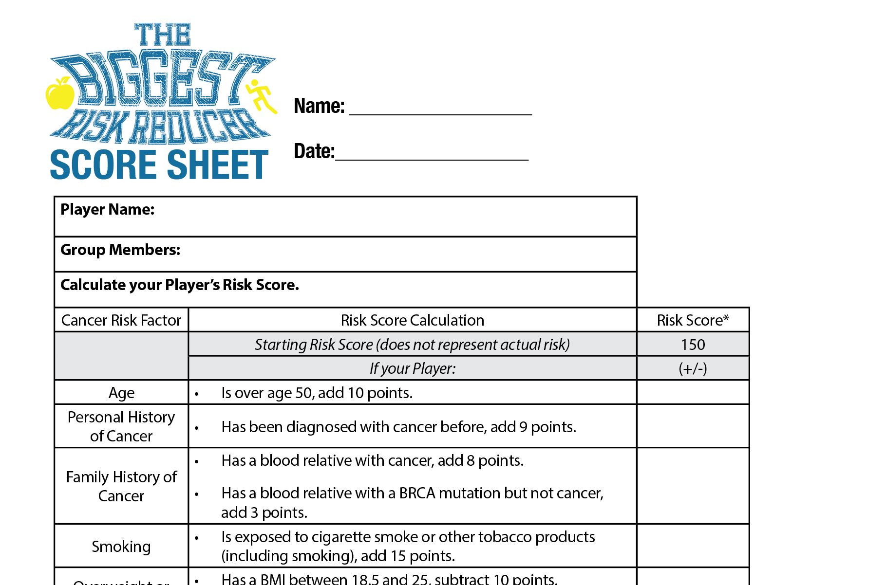
Notes:
Instructor Notes
Distribute copies of Biggest Risk Reducer Score Sheet to each group. Have students review the information about cancer risk factors and complete the Score Sheet to determine their Player’s Baseline Risk Score.
Note: The numbers used on the Score Sheet are only used for purposes of playing the game; they do not represent actual extent of risk. One of the questions requires students to calculate their Player’s BMI. BMI is a number calculated based on weight and height. It is used to measure overweight and obesity status. A calculator is available online at http://www.cdc.gov/nccdphp/dnpa/bmi/. There are separate calculators for adults and children/teenagers. Students may calculate BMI using the following formula: BMI = [(weight in pounds)/(height in inches)2] x 703. An individual with a BMI >25 is considered overweight, >30 is obese.

Slide 28
Notes:
Instructor Notes
Tell the class they will be developing a strategy to reduce their Player’s cancer risk. Distribute the Risk Reduction Strategy worksheet. Ask each group to select one unhealthy behavior their Player engages in (this will be their Target Behavior) and develop a preliminary plan for how their Player can change this unhealthy behavior based on their own personal knowledge and experiences. Their goal is to develop a realistic and manageable strategy for helping their Player reduce their cancer risk. The group that helps their Player lower their Risk Score the most will be the “Biggest Risk Reducer.”

Slide 29
Unhealthy Eating
Inadequate Physical Activity
Irregular or No Cancer Screenings
Irresponsible Alcohol Use
Tobacco Use (smoking)
Notes:
Instructor Notes
Tell students that these are some examples of target behaviors.

Slide 30
Select one unhealthy behavior your Player engages in and develop a plan to change that behavior
Notes:
Instructor Notes
After each group completes a preliminary plan, distribute one Chance Card specific to their Target Behavior. For example, a group that chose inadequate physical activity as their Target Behavior would receive one Exercise Chance Card. Allow students to review their Chance Card and update their Score Sheet.

Slide 31
Notes:
Instructor Notes
Based on their target behavior change from the preliminary plan, distribute one chance card specific to their target behavior

Slide 32
+
=
Notes:
Instructor Notes
Tell the class that research has provided some insight into how to help people change a behavior. Tell students that in order to gain clues about how to help Players change a behavior, they must compete in a Physical Challenge, just like in a reality show, such as “The Biggest Loser.” Groups must use their knowledge about breast cancer and their physical endurance to win clues about how to write a more
effective risk reduction strategy.

Slide 33
The teacher is the Judge
Each group will rotate among different Stations. At each Station, groups must answer as many questions about breast cancer correctly as they can in two minutes
While a Team is at a Station, one group member (the Mover) must remain in motion at ALL times
Notes:
Instructor Notes
Provide the class with Physical Challenge rules on this slide and the following slide.

Slide 34
If any Mover stops, their Team must step away from their Station, regardless of whether they have completed their questions
After two minutes, the Judge calls time. The Judge collects the completed Question sheets and the Teams move to the next Station
At each new Station, another group member should be the Mover so that each student is the Mover at least once
Notes:
Instructor Notes

Slide 35
Activities for the Movers:
Running
Marching in place
Walking around the classroom
Jumping jacks
Dancing to music
Notes:
Instructor Notes
Have each group select their first Mover and Station. Distribute the first Question sheet to each Station. Call “Start” and begin timing two minutes. Circulate among groups to make sure they are answering questions and Movers are constantly moving. After two minutes, tell the class time is up. Teams turn in their completed Question sheets and move to the next Station. The role of Mover should rotate to the next group member. Continue playing until each group has visited all stations.
Note: If you do not have enough space for students to rotate around stations, you can modify the activity. Have students sit in groups and designate a place in the classroom for the Movers. Give each group the same set of Questions and time them. After the allotted time, collect the Questions, distribute the next set of Questions, and have the Mover for each group rotate to the next member until all Questions are completed.

Slide 36
Clues about how to write a more effective risk reduction strategy
Breast cancer knowledge
Physical endurance
Notes:
Instructor Notes
Review the answers with the class and determine which group is the winner of the Physical Challenge (the group with the most correct answers wins). The winning group may subtract an additional 6 points from their Player’s Baseline Risk Score; all other teams may subtract 2 points if they made an effort in the Challenge.

Slide 37
Winner of the Physical Challenge: Receives 15 clues for their Target Behavior.
2nd Place: Receives 10 clues for their Target Behavior.
3rd Place: Receives 8 clues for their Target Behavior.
4th Place and below: Receives 5 clues for their Target Behavior.
Notes:
Instructor Notes
Distribute What Determines Health? to each student and the Behavior Change Clues to each group based on their Target Behavior and their performance in the Physical Challenge, using the process on this slide. The clues for each group may be randomly selected.

Slide 38
Notes:
Instructor Notes
Tell students they should use their clues to revise and refine their risk reduction strategy for their Player. Strategies should be realistic. Allow groups enough time to discuss their strategy and complete or revise their Risk Reduction Strategy worksheet.
Learning Activity: Presenting Risk Reduction Strategy
Have each group introduce their Player and present their Risk Reduction Strategy to the class. Use the Rubrics for Judging Risk Reduction Strategies to score each group’s strategy. Strategies are scored based on how well the strategy conforms with behavior change science. Points are assessed based on each strategy’s potential to reduce cancer risk.

Slide 39
Notes:
Instructor Notes
Have students update their Score Sheet with the results of the assessment of their Risk Reduction Strategy and calculate the percentage they reduced their Player’s risk score from the Baseline score to Final Risk Score. The group with the Player who reduces their cancer risk the most is the “Biggest Risk Reducer.”

Slide 40
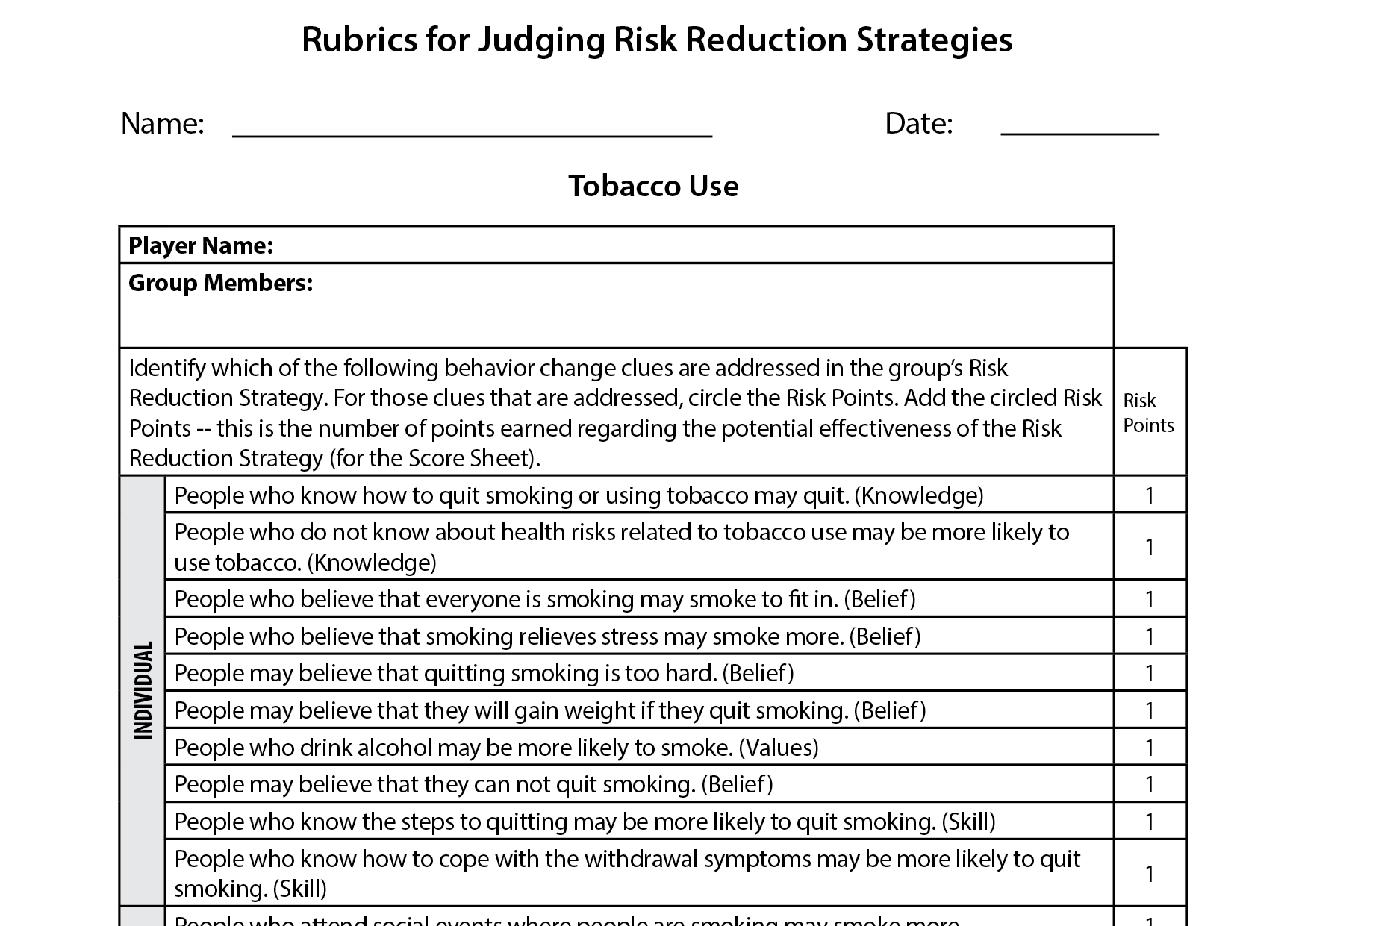
Notes:
Have students assess themselves, their peers and their group on the strategies

Slide 41
Notes:
Instructor Notes
Pass out the Lesson 5 Quiz to assess students’ understanding of Lesson 5 objectives.

